Slide 1
Amateur Radio
Emergency Communications
Basic Training
ARRL EC-001
March 29, 2014
ALACHUA County ARES/RACES
EMCOMM Training
Northern Florida Section ARRL
Original Training Presentation developed By AD7FO Spokane County AEC

Slide 2
What is a Communication Emergency
LU 1
Occurs when a critical communication failure exists that puts the public at risk.
A variety of circumstances can overload or damage critical day to day communication systems…
    Storms that knock down communications infrastructure or lines
    Fires in telephone equipment buildings
    Vehicle penetration into 911 communications center
    Buried fiber optic cable cut by backhoe
    Disruption in power
    Terrorist attack
    Disaster like earthquakes, tsunami's, hurricanes,
    ice storms, forest fires, volcanic eruptions, etc

Slide 3
ARES/RACES EMCOMM Volunteers
LU 1
Volunteers come from a wide variety of backgrounds and have a wide range of skills.
Share a desire to help others without personal gain of any kind
Train and practice to improve their communication skills
Can work together as a team and
take direction from others
Can think and act quickly under the stress and pressure of an emergency

Slide 4
Where does Amateur Radio Fit In?
LU 1
A Skilled and equipped communications resource for our Served Agencies*
We do Public service events to practice our skills
(March of Dimes, Five Points Marathon, Veteran’s Day Ceremony, Operation Santa Delivery)
We do practice drills with our Served Agencies to improve our skill in a more realistic scenario and to demonstrate our skills
We are not a single communication channel, system or network, we are dynamic and can adjust to the needs of the situation
* Served Agencies are those we have commitments both local and national through ARRL agreements to provide communications when called upon like NOAA (SKYWARN), Red Cross, Emergency Management, Hospitals, etc.

Slide 5
Where does Amateur Radio Fit In?
LU 1
We are “communications commandos”
We are licensed and have allocated frequencies
for local, national and international communication
We can dynamically enlarge and expand our communications network as the situation changes.
We practice many of the needed skills for emergency communication in our daily amateur radio activates
    Directed nets
    HF communications, Changing bands as necessary to maintain communication
    Field Day
    Mobile operation

Slide 6
What Amateur Radio ECOMM is not
LU 1
We are not first responders, will not be the first on scene
We have no authority and can not make decisions for others
It is your decision if you can participate or not, especially if these decisions affect your own health and welfare
You are not in charge
You are there to temporally fulfill the needs of a Served Agency who's communication system is unable to do it’s job
It is not your job to backfill another job when the agency is short of personnel. Your job is communications. You can however help in other areas if you are qualified and do not compromise your primary job of communications

Slide 7
Day to Day versus Emergency Comm.
LU 1
In day to day communications there is no pressure to get a message through and no one’s life is dependent on your getting a message through
Emergency communication can involve
non-Amateurs and Amateur operators working together
Emergency operations occur in real time and
can not be put off to a more convenient time
Emergency communications must be staffed and set up quickly with little or no warning
Following net protocol and giving short, concise messages is imperative

Slide 8
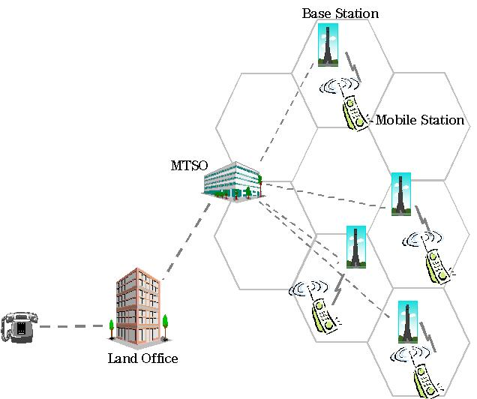
LU 1
Day to Day versus Emergency Comm.
Unlike home operations, emergency stations must be portable and easy to set up quickly
Emergency operation may carry over several hours to several days
Emergency communicators may need to interact
with several organizations simultaneously
Emergency communication fills in where
commercial systems fail from not having
enough reserve capacity. Amateur radio
operator skill, equipment, and
knowledge can create additional
communications capacity in a very short time

Slide 9
Communicating is job #1
LU 1
While we are skilled operators, with impressive equipment, and systems in place, our job is to communicate for our Served Agency by any appropriate communication method available to us
If asked to pass a complex message or detailed lists and a fax machine is available then it might be a better choice than radio voice communication.
Always use the best method available and appropriate for the traffic that needs to be communicated
If the target recipient only has an FRS radio or CB radio it would be appropriate to use them. Our message handling skills will work on any communication link, including using a telephone

Slide 10
A Communications Emergency Anatomy
LU 1
In early phases of many disasters there is no immediate need for communications services. This phase might occur during a severe storm watch.
You can use this time to monitor the situation to prepare to deploy if and when a request for assistance comes.
Once a potential need for more communications resources is identified, a Served Agency will put out a call for volunteer communicators.
You could be asked to operate from an emergency operations center or field location.
Do not count on electrical power being available at the location you are sent to.

Slide 11
LU 1
A Communications Emergency Anatomy
In some ARES/RACES organizations there is a designated Rapid Response Team (RRT) that can deploy with a minimal capability in a very short time. The RRT would be backed up by a more robust response in an hour or two.
In a larger response a resource or logistics team may be needed to coordinate incoming volunteers and resources to direct those volunteers and resources to where they are needed most.
In a large event there may be multiple nets in operation on different frequencies.

Slide 12
LU 1
Communications Emergency Anatomy
As an event progresses traffic may increase, be sure you prepare for this during the initial phase when traffic is lighter.
For a long term event, operator rotation, food & water, and sleeping accommodations will need to be considered.

Slide 13
LU1 Review
LU 1
A communications emergency exists when critical communications systems fail or are not available and the public is put at risk.
At the end of a communications event or exercise it is important to review the effectiveness of the response and look for ways to improve the next time.
It is not appropriate for an emergency communicator to make demands on the agency being served.
The function of a Rapid Response Team (RRT) is to deploy a quick response in a short time.
Do not use person to person voice (grapevine) to transmit you messages.

Slide 14
Amateurs as professionals
The served agency relationship
LU 2
Your attitude is everything! It is more important than your radio skills and equipment. Historically speaking attitudes of some Amateur Radio volunteers has been our weakest point. As one Served Agency once put it “working with ham radio operators is like herding cats”
Although our name says “amateurs” it’s real reference is to the fact that we are not paid for our efforts. We are professional and have the skills and equipment to do an excellent job when called upon.

Slide 15
Who Works for Whom
LU 2
When serving an agency keep in mind that we are and are viewed as un-paid employees of that organization. If we keep this in mind our relationship with the agency will be on track.
It does not matter if you are an ARES/RACES member or one of the agencies regular volunteer force, they will treat us the same.
It is a misconception that volunteers do not need to take orders. You are expected to comply with instructions from a Served Agency as long as you are able to carry them out safely and do not constitute something that is against FCC regulations (such as going onto the police frequencies).

Slide 16
Professional Emergency Responder View
LU 2
Unless a positive long term relationship exists between the professionals and volunteers, Professionals are likely to view the volunteers as less than useful. They do not want to do OJT (On the Job Training) during an emergency event and need to know they can
depend on the folks they are working with.
Volunteers may be viewed as “part-timers” whose skill level and dedication can not be depended upon when needed.
Working successfully with our Served Agencies during drills and exercises can make a big difference in the way ARES/RACES operators are viewed.

Slide 17
Performing Non-Communication Roles
LU 2
It has been said that it is a hard and fast rule that communication should be our only role. The answer is yes and no.
In today’s fast paced emergency responses there is not enough time for a rigid set of rules. Communication must move at the same speed. Today’s reality is that any job that involves communication may be what we are asked to do. For this reason we need to have an understanding of what our Served Agencies expect of us.

Slide 18
Typical Radio Roles We Might Perform
LU 2
Radio operator using Amateur or Served Agency radio systems.
Dispatcher organizing the flow of personnel, vehicles or supplies.
Field observer watching and reporting weather
or other conditions.
Damage Assessment, recording & reporting conditions.
Searcher, providing communications for a search and rescue team.

Slide 19






Specific Agency Relationships
LU 2
At a national level ARRL has agreements in place with many agencies:
    Memorandums of Understanding (MOU’s)
    Statements of understanding, (SOU)
    Statement of affiliation (SOA)
Some of the agencies where agreements exist are:
    Red Cross
    Salvation Army
    Department of Homeland Security
    Federal Emergency Management Agency (FEMA)
    NOAA/National Weather Service - SKYWARN
    Local Department of Emergency Management (DEM)

Slide 20
Talking to the Press
LU 2
Do Not Talk to the Press
The press is looking for any information they can find and you will most likely know something they would like to know.
It is not your role to be disseminating information to the public. There will be a Public Information Officer assigned to the event or as part of the responding agency you are serving. Refer all questions from the press and others to the event or agency to the PIO.
No matter how persistent the questioner is you are not authorized to disseminate information. If they do not leave when asked, talk with your ARES/RACES or Agency management personnel and ask them to resolve the problem.

Slide 21
Operating Where You Are Not Known
LU 2
When you are in an area away from home monitoring a local net and hear an emergency call for local ARES/RACES members, do not just show up.
If you are willing and able to help, check into to the net and advise the net control your capabilities and your availability. They will determine if you can be utilized.
Do not be offended if your offer to help is refused. The local net control is thinking about his/her team dynamics, operator skill level needed (yours is unknown to them), specialized training, whether or not more operators are required, local access credentials (background checks) and insurance issues.

Slide 22
Workman compensation & Legal Issues
LU 2
In some States Workman's Compensation is extended to volunteer workers working on behalf of a government or non profit organization. This is a complex issue and needs to be explored in advance of a call out.
Volunteers providing services to government agencies are provided immunity from liability by federal law through the Volunteer protection act of 1997, 42 U.S.C. section 14501. There are exceptions, check details of the act before assuming your activity is covered.

Slide 23
LU2 Review
LU 2
Your main job as an emergency communicator is as a radio operator using amateur or Served Agency radio systems.
In the role of a modern emergency
communicator you may be asked to
serve any function that includes
communication.
If you are asked by the Served Agency
to do a task that falls outside the FCC
rules, discuss the situation with them
and develop an alternative solution.

Slide 24
LU2 Review
LU 2
5. If you are operating as an emergency
EMCOMM group and receive an inquiry
from the press refer them to the Served
Agencies PIO (Public Information Officer).
6. Your attitude will have the most effect
on your relationship with a Served
Agency

Slide 25
Network Theory
The Design of Emergency Comm. Systems
LU 3
The study of information transfer between multiple
points is known as “Network Theory”
Network theory can be thought of as the process of matching a particular message to the best communication pathway. The best pathway efficiently transfers the information utilizing the minimum of the available communication resources while accurately and dependably transferring the information.
By participating in Served Agency emergency planning hams can incorporate fundamental concepts of network theory into their plans so that appropriate modes and resources are available for a real emergency

Slide 26
Single vs. Multiple Destinations
LU 3
In most cases our communication is from one person/site to another. This is point to point communication that may be monitored by other sites or individuals who need to know what is going on, or who may be able to provide requested resources.
Messages for multiple destinations are called broadcast messages. This might be a weather advisory that is of interest to everyone or an open request for resources from anyone on the net.

Slide 27
Message Precision vs. Accuracy
LU 3
Precision is not the same as accuracy. Accuracy is important in all our message handling.
  “The hiker has been found in the meadow and in good health” some mistakes in this message at the character level (spelling) will still allow the information to be accurately received and understood.
  A list of names, request for medical supplies, etc require precision at the character level when being sent or received, especially when voice communication is used.
It is important to understand the level of precision needed. Packet is a good choice for high precision messages but may be to cumbersome for simple communication where voice is quicker and easier.

Slide 28
Complexity -Timeliness - Priority
LU 3
Detailed instructions may be simple to send via voice but if the instructions are too long, the person on the other end may not get it correct. Precision may not dictate written communication, but complexity might.
Timeliness of a message needs to be considered. As you plan your message transmission order, consider if a delay can be tolerated or not.
Priority traffic: If you receive a message that you are told is a priority message, stop what you are doing and send it immediately by the fastest appropriate method.

Slide 29
Communication Methods
LU 3
Telephone- (land line and cellular)
  One to one
  Requires infrastructure
  May be overloaded
  Not good for high precision messages
  May not have coverage (cell phones)
Fax
  Utilizes phone network
  Good for high precision messages
Two way Voice Radio
  One to one or broadcast messaging
  Not good for high precision messages

Slide 30
Communication Methods
LU 3
Trunked Radio systems
  Already at high utilization, and sky rocket during an emergency
  Radios (users) have assigned priorities, getting a higher priority requires reprogramming the radio
Packet Radio
  Good for high precision messages
  Can provide permanent record of message (printed/stored)
  Good for broadcast messaging (multiple addresses)
  Easily forwarded to another station (with or without notes)
  May not be reliable for marginal transmission paths
  Not good for graphics transmission

Slide 31
Communication Methods
LU 3
Store and forward systems
  Bulletin boards
  Mailboxes
  Good when sender and receiver are not simultaneously available
Other
  ATV –Amateur TV (fast and slow scan)
  Satellite communication
  Internet
  Human courier

Slide 32
Planning and Preparation
LU 3
The key to successful emergency communication is effective planning and preparation.
  What kind of information will need to be communicated?
    Long detailed messages
    Simple status checks, information, questions
    Maps or other graphic content
    How frequent will messages need to be sent and received
    Think about where you may be deployed and how you would operate from there. (Special Needs: Food, Water, Medications?)
    Think about the problems you will encounter and plan to handle them in advance
    Go kits for simple communication and more complex communication such as packet and Win Link-2000
    Periodic checks on the gear and supplies in you go bags

Slide 33
LU3 Review
LU 3
A secure mode should be used to communicate a list of injuries or causalities
Fax would be good for sending high precision, lengthy and complex messages, and graphics like maps.
A packet bulletin board would be good for non time critical messages and reference material when sender and receiver can not be available simultaneously

Slide 34
LU3 Review
LU 3
4. The pitfall of Telephones, Cellular Phones
and Trunked Radio systems is that they
all require a complex central switching
system that is subject to failure in a
disaster situation
5. Sending a shelter list via an office FAX
would be an example of efficient
communication. Remember efficient
communication does not need to
involve a radio.

Slide 35
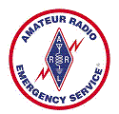
Emergency Communication Organization & Systems
LU 4
To be effective in an emergency situation;
  Your team must know and trust each other and each others capabilities
  Must understand their role as a leader or follower
  Must be able to solve problems that arise
ARES® provides structure, training and practice to accomplish the above. ARES® has been part of the ARRL since 1935

Slide 36
Emergency Communication Preparation/Training
LU 4
Unless a positive long term relationship exists between the professionals and volunteers, Professionals are likely to view the volunteers as less than useful. They do not want to do OJT (On the Job Training) during an emergency event and need to know they can
depend on the folks they are working with.

Slide 37

Emergency Communication Planning & Organization
LU 4
The key to successful emergency communication is effective planning and preparation.
Organization is critical to any emergency response. Without an organization that plans and prepares in advance, an Amateur Radio emcomm response is likely to be disorganized and ineffective

Slide 38
Northern Florida
ARES Organization
LU 4
ARRL Northern Florida Section
Paul Eakin, KJ4G
SM
AEC
WA4JD
Allan West
WB4OMM
Steve Szabo
SEC
AEC
KG4VWI
Susan Halbert
From
Surrounding
Districts
AEC
DEC
W4UFL
Jeff Capehart
Santa Fe District
DEC
AEC
W4UFL
Jeff Capehart
Alachua County
EC
From
Surrounding
Counties
AEC
EC
AEC

Slide 39
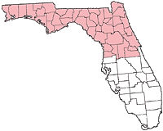
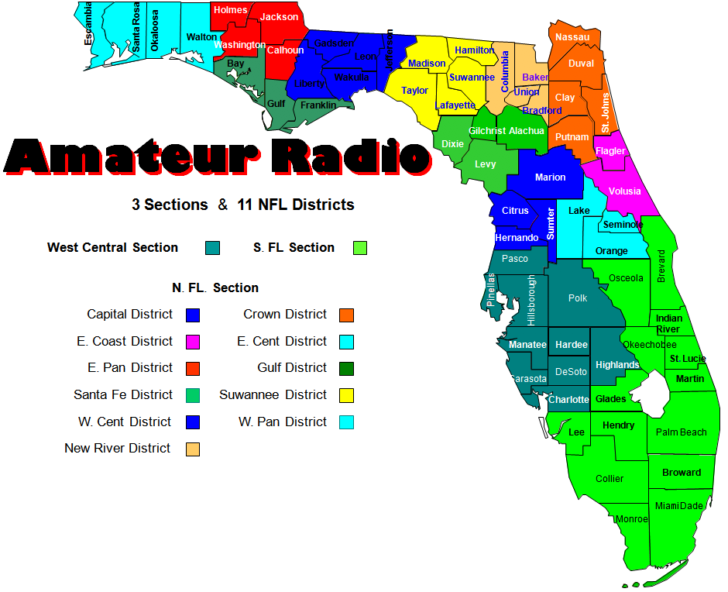
Northern Florida ARES
Santa Fe District
LU 4

Slide 40

LU 4
RACES
Radio Amateur Civil Emergency Service
Created by the Federal Government after
World War II
Provides rules to address the need for Amateur Radio operators as an integral part of state, county or local Civil Defense agencies (known as Emergency Management) during a time of national emergencies or war.
RACES has authorization to operate even if the President or FCC suspend normal Amateur Radio operation.
At one point in time some Civil Defense agencies were RACES licensed for Amateur radio with amateur licenses. These are no longer issued, and can no longer be renewed.

Slide 41
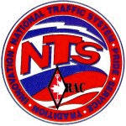
Other Organizations
LU 4
Salvation Army Team Emergency Radio Network (SATERN)
  Used for logistical communication between offices and health and welfare messages
  At local level ARES, REACT and other groups help support their radio operations
National Traffic System (NTS)
  Organized and scheduled nets on amateur radio to pass messages, including third party messages.
  Can be used to get messages over long distances
  Trained and experienced at message handling

Slide 42

LU 4
Other Organizations
Military Affiliate Radio Service (MARS)
  Department of Defense Sponsored Auxiliary Communication network
  Three separate managed and operated programs
    US Army
    US Navy/Marines
    US Air Force
  Nets on special assigned/allocated military radio frequencies adjacent to the Amateur bands.
  Special Call signs are issued for MARS use
  Strict rules on message content and structure
  Mars is a backup military, federal, state and local communications network during times of emergency

Slide 43
LU 4
Other Organizations
Federal Emergency Management Agency (FEMA) &
FEMA National Radio System (FNARS)
  A FEMA high Frequency Radio network designed to provide minimal essential emergency communication capability among federal, state, local commonwealth and territorial governments in time of emergencies.
  FEMA monitors the FNARS frequencies on a daily basis at the state level, typically located in the state emergency Operations Center (EOC).

Slide 44

LU 4
Other Organizations
National Communication System (NCS)
  A federal agency that consists of 23 government organizations tasked with ensuring the federal government has the necessary communications capabilities under all conditions from normal day to day to national emergencies. The manager of NCA is also the Director of Defense Information Systems Agency (DISA), Usually an Air Force General.

Slide 45

Emergency Communication
may be more than ARES/RACES
LU 4
A variety of government and private emergency communications groups assist in time of disaster. While Amateur Radio groups operators may not interact with many of these systems, it may help to know that they exist, since a served agency with which we may work may utilize or interact with one or more.

Slide 46

LU 4
Other Organizations
REACT
A national EMMCOM group whose operators
can be from Citizen Band (CB) radio operators,
Amateur Radio, GMRS, FRS, and MURS.
Has an organizational structure similar to ARES with local teams who directly work with some of the same Served Agencies that are supported by ARES
REACT’s mission is somewhat broader that ARES. They can provide:
  Crowd control
  Logistics
  Public education
  May not include communication

Slide 47
LU 4
Other Organizations
Emergency Alert System (EAS)
The Emergency Alert System (EAS) is a national public warning system that requires broadcasters to provide their communications capability to the President to National emergency.
The system also may be used by state and local authorities to deliver important emergency information such as AMBER alerts and weather information targeted to a specific area.

Slide 48
Organization for rapid Response
Rapid Response Team (RRT)
LU 4
An RRT is a small group within a larger
EMMCOM organization that can put a few
strategically placed stations on the air quickly
  A level 1 team can deploy within ½ hour of the start of an emergency with short term Jump kits for 12 to 24 hours
  A level 2 team will deploy within hours with more communications and a 72 hour longer term deployment kit that might include:
    Tents, sleeping gear, change of clothes, portable repeaters, extended food and water, personal medications as needed, spare radios, Generator, etc.
  These teams may go by other names such as Quick Response team (QRT), or Rapid Emergency Deployment team (RED team)

Slide 49
Organization
ARES Mutual Assistance Team (ARESMAT)
LU 4
An agreement with other ARES groups to
provide assistance and resources in the
event of:
  A communications emergency lasting longer than
  a day or two
  An emergency that requires more resources than are
  available locally.
Teams consist of hams who are willing to travel to
another location
  As an ARESMAT member you are under the direction
  of the local group that made the request. They are in
  essence a Served Agency that you are working for.

Slide 50
LU4 Review
LU 4
The ARES organizational structure
is best defined by the
ARRL Field Organization as
ARRL – Section – District – County
Within a Section, the ARES
Chain of command is:
  Section Manager (SM)
  Section Emergency Coordinator (SEC)
  District Emergency Coordinator (DEC)
  Assistant District Emergency Coord. (ADEC)
  Emergency Coordinator (EC)
  Assistant Emergency Coordinators (AEC)
Assistant DEC
ARRL Director
Greg Sarratt
W4OZK
KJ4G
Paul Eakin
SECTION MGR
W4UFL
Jeff Capehart
ALACHUA
WB4OMM
Steve Szabo
SEC
KJ4YPY
Mike Simpson
GILCHRIST
W4UFL
Jeff Capehart
DEC
VACANT
DIXIE
VACANT
LEVY

Slide 51
LU4 Review
LU 4
            A level 2 RRT (Rapid Response Team) responds within a few hours and is prepared with 72 hour jump kits for a longer duration of service.
            An ARES Mutual Assistance Team (ARESMAT) is an ARES team willing and able to travel to another area.
            A REACT teams resources may include CB, Amateur Radio, GMRS, FRS, and MURS radio equipment

Slide 52
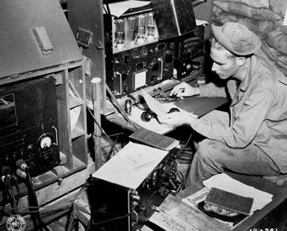
Served Agency
Communication Systems
LU 5a
Most Served Agencies may have their
own equipment ranging from modest to
complex.
You should work in advance with the served agency to determine if you will bring and operate your equipment or use theirs.
Served Agency equipment may be quite different than Ham Radio Equipment. You will need to understand how to operate it.
Operating protocol and terminology may be different. Practice drills will help prepare you to use served agency radio equipment.
All communication needs to be succinct and professional – no casual conversations.

Slide 53
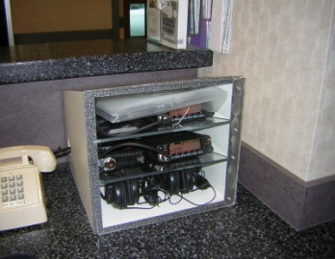
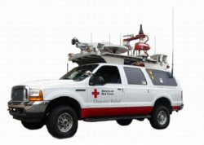
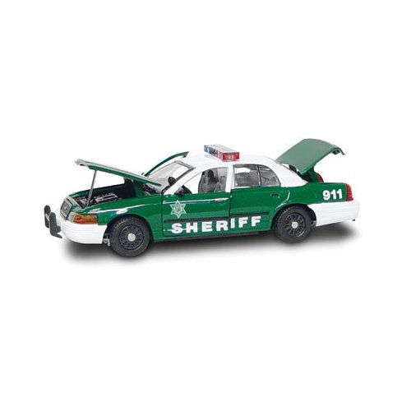
Served Agency
Communication Systems
LU 5a
Potential Served Agency Systems
  Medical Radio Systems
    HEAR System
    Newer Hospital Emergency Radios have 10 UHF
    duplex frequencies and 7 VHF simplex frequencies
    Amateur Radio installed at SHANDS
  American Red Cross – National Freq 47.42 MHz
    ECRV Vehicle as well as ERV vehicles
    Chapter Radios
  Police
  Public Safety groups moving to a new
  digital communications system, APCO-25
  Emergency Management (EM)
    Communications Trailer

Slide 54
Communication Systems
LU 5a
  There are three types of shared or multiple user radio systems you may encounter:
    Community (or city wide) repeaters where multiple using agencies share the same repeater frequencies. The users are differentiated by CTCSS tones from the repeater. You must press the monitor button on your radio to see if the frequency is in use by another agency before transmitting.
    Shared simplex frequencies which share the same concept of differentiating users by CTCSS tones except on simplex. Again press the monitor button to insure the frequency is not in use before transmitting.

Slide 55
Communication Systems
LU 5a
  Trunked Radio Systems
    In a trunk radio system, all users share a pool of frequencies from five up to a maximum of twenty-eight. Users are assigned a "group id" and field radios are programmed to only pick-up transmissions for that group. A computer, called the "site controller", automatically assigns a frequency for users belonging to the same group to communicate with each other. This is done over a data channel called the "control channel", which carries data that tells field radios what frequency they are on. Trunk radio systems may have one or more control channels.

Slide 56
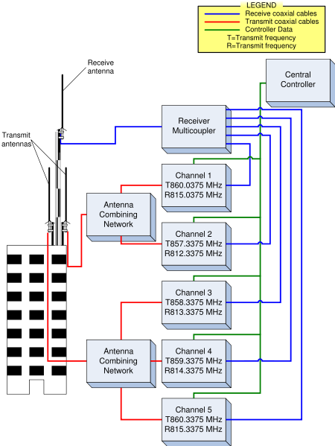
Communication Systems
LU 5a
Trunked Radio Systems
  Since communications on a Trunked System never stay
  on one frequency, monitoring these
  communications with a conventional
  scanner is virtually impossible,
  especially in large metro areas where
  a Trunked System can have dozens
  and dozens of users.
  Because Trunked Systems require
  complex repeaters and radios in
  addition to designated/reserved
  frequencies they are not currently
  used for amateur radio communication
  Trunked systems can prioritize users
  when there is a lot of traffic

Slide 57


Served Agency
Communication
LU 5a
Additional Communications Equipment you may be asked to operate
  Fax Machines
  Copiers
  Computer terminals – To send or forward messages via e-mail

Slide 58
Disaster Preparedness
LU 5b
Neighborhood Watch Program
Homeowners Association
Community Emergency Response Team (CERT)
Local Disaster Response Training
Preparedness classes
DHS/FEMA ICS (IS-100) & NIMS (IS-700)

Slide 59
Community Emergency
Response Teams (CERT)
LU 5b
Trains in light search and rescue
IS-317 Introduction to CERT
Classroom training course taught by Emergency Management

Slide 60

LU5 Review
LU 5a
When emcomm members are called upon
to operate on public safety radio they
may not engage in casual conversations.
Motorola’s trade marked name for CTCSS is
PL or Private line
The newer medical emergency medical
radio service uses 10 UHF Duplex
frequencies and 7 VHF simplex channels.
Amateur Radio does not currently use
(or allow) the Trunked Radio System
format.

Slide 61
LU5 Review
LU 5a &5b
5. When EMMCOMM teams work with Served Agencies the Served Agency must provide training if Amateur Radio operators are to be used effectively.
  6. Amateurs might contact Neighborhood Watch, Homeowners Association, and CERT Teams for community preparedness efforts.
  7. CERT is a volunteer program of trained people operating in teams under ICS protocols.

Slide 62
Basic Communication Skills
LU 6
The job of an Emergency Communicator is to get the
message through to an intended recipient quickly and accurately. Your ability to do this may be limited by:
    Operator Skills
    Communication method
    Noise –Electrical in the transmission path and acoustical at the receive and transmit site when voice is used.
Important skills for a communicator are:
    Listen - Tune out distractions (use a headset if possible) and when unsure of what you heard ask that it to be repeated.
    Be sure the message you copy is correct, ask for a
    read-back to be sure.

Slide 63
Use Good Microphone Technique
LU 6
  Speak across the microphone not into it (unless you use a desk mike)
  Use your normal clear, calm voice. Do not raise you voice or shout
  Determine the voice level and microphone gain that works best for you
  Wait a second or two after keying the Microphone before speaking to allow the repeater to come up
  VOX is not recommended for emergency communication
  Pause between transmissions to allow for emergency traffic
  Remember if using a repeater most have a 3 minute time out, but try to limit your transmissions to one minute then break to check for emergency traffic

Slide 64
Use Plain Language
LU 6
Do not use slang or jargon (technical slang)
Do not use Q signals in voice transmissions
Use simple language; “big words” may not be understood by all
Avoid words and phrases that carry strong emotion
Use Proper Phonetics:
A- Alpha I- India Q- Quebec Y- Yankee
B- Bravo J- Juliet R- Romeo Z- Zulu
C- Charlie K- Kilo S- Sierra
D- Delta L- Lima T- Tango
E- Echo M- Mike U- Uniform
F- Foxtrot N- November V- Victor
G- Golf O- Oscar W- Whiskey
H- Hotel P- Papa X- X-ray

Slide 65
Use Pro-words
LU 6
Clear- end of contact
Over- used to let a specific station know when to
respond
Go ahead- Used to indicate that a station(s) may
respond
Out- Leaving the air, will not be listening
Stand by- A temporary interruption of the contact
Roger- Indicated the transmission has been received
correctly and in full

Slide 66
Using Tactical Calls
LU 6
You do not need to know called stations FCC call sign
Makes the function/station location you are calling clear
Avoids confusion during shift changes
Use tactical call signs for public service and emergency events
You still need to identify with your FCC call sign every 10 minutes
Identifying at the end of each transmission will indicate the end of transmission and insure you meet the FCC identification rule

Slide 67
LU6 Review
LU 6
In emergency communication listening is 50% or greater, not 10%
When transmitting, talk across the microphone rather than directly into it
In emergency communications never use 10 codes on Amateur Radio
On a tactical net it is still necessary to identify with your call sign at a minimum of every 10 minutes and at the end of your last transmission.
Giving your call sign is the most effective way to end an exchange on a tactical net.

Slide 68
Introduction to Emergency Nets
Information:
LU 7a
The Purpose of any net is to provide a
means for orderly communication within
a group of stations
An emergency net is a group of stations
who provide communication to one or more
Served Agencies or the General public in a communications emergency.

Slide 69
Introduction to Emergency Nets
Information:
LU 7a
A formal or directed net is one with a
NCS (Net Control Station) who organizes
and controls all communication on the net.
To send a message you must ask permission
from the NCS. Then NCS will authorize message transfer in an orderly fashion, frequently on another frequency, based on message priority.
Directed Nets are the best format when there
are a large number of stations and/or a lot of
traffic.

Slide 70
Introduction to Emergency Nets
Information:
LU 7b
On Open (Informal) Nets, the NCS is optional
allowing stations to call each other directly. The
NCS, if there is one, steps in only if necessary
when there is a large amount of traffic or
problems arise. Open Nets are usually used
when there is little traffic and only a few
operators.
Most of the local ARES / RACES activities will
use formal nets.

Slide 71
Introduction to Emergency Nets
Types of Nets:
LU 7a/b
Traffic Net – Handles formal written traffic in a
specified (ARRL) format. Traffic Nets operated
by the National Traffic System (NTS) are excellent examples of how an ARES / RACES formal traffic net should operate.
Tactical Nets are used for real time coordination
of activities related to the emergency. A tactical
net usually has an NCS but may be directed or open.
Resource or Logistics Nets may be needed to
acquire resources (food, water and other
supplies), accept volunteer check-ins and hand
out assignments. This is usually a directed net.

Slide 72
Introduction to Emergency Nets
Types of Nets:
LU 7
Information Nets are usually Open Nets used
to collect and share information on a developing
situation without overly restricting the use of the frequency by others. Net members send updated
local information as needed and bulletins from
Served Agencies.
A good example of an Information Net is a
SKYWARN weather net activated during
a severe storm.

Slide 73
Introduction to Emergency Nets
Checking into an Emergency Net
LU 7
You need to “check in” to a net:
  When you first join the net
  When you have messages, questions or information to send
To become part of a directed net wait for NCS to ask for “check-ins” and listen to any specific instructions such as “check-ins with emergency traffic only”
At the appropriate time (or when directed) check in with:
  Your call sign only
  Your call sign followed by “with traffic”
  Your call sign followed by “with Priority Traffic”
  Your call sign followed by “with emergency Traffic”
  Then wait for NCS to respond before offering more
  information

Slide 74
Introduction to Emergency Nets
Checking into an Emergency Net
LU 7
If there is a long time and NCS has not asked for
check-ins and you have traffic or information you
may briefly call NCS when there is a break in
activity by stating your call sign
If you have emergency traffic do not wait to be
called. Call Net Control as soon as there is a break in the conversation

Slide 75
Introduction to Emergency Nets
Checking into an Emergency Net
LU 7
If you are not part of the organization, do not
just check in and offer to assist. Listen for a
while to understand the situation, what may
be needed and what you might offer the
organization.
If you feel there is a need and something you
can offer to meet that need, you can check-in
briefly and ask NCS if there is a resource net
in operation, and go there. If there is no
resource net in operation make a brief offer of
assistance to NCS.

Slide 76
Introduction to Emergency Nets
Checking into an Emergency Net
LU 7
Do not be too surprised if you receive the “cold Shoulder” when checking into a net where you
are not a member. The NCS on that net does
not know your technical skills or your ability to
work with their team. If you have a specific skill
you feel may be useful to their operation be sure
to mention it.
If offered a menial task, take it, The NCS will get to know you and you could be freeing up a needed member of their team.

Slide 77
LU 7
Introduction to Emergency Nets
Passing Messages
When Checking into a net, tell the NCS you
have traffic to pass. They will usually ask you to
“list your traffic” with it’s destination and priority.
You will not send your traffic until NCS tells you to
do so, more than likely on a different frequency. Normally, NCS will tell the receiving station to contact the sending traffic station for traffic.
If you went to another frequency after passing your traffic, return to the net frequency and tell NCS you have passed your traffic so they can remove it from their list.
If using Tactical calls be sure to also add your call at the end of your transmission.

Slide 78
LU 7
Introduction to Emergency Nets
“Breaking” into the net
If the net is in progress and you have emergency traffic to send, you may have to “break” into the net
  Wait for a pause between transmissions and
  simply say ”break <your call>” and wait for NCS
  to respond by saying “<your call> go with your
  traffic”
  You would reply “<your call> with emergency traffic”

Slide 79

LU 7
Introduction to Emergency Nets
Checking out of an emergency net
Always let NCS know you are leaving the net,
even if it is for a few minutes. If you do not
respond NCS may become concerned
and be forced to use valuable resources to
check on you.
There are three reasons for leaving a net:
  The location of your station is closing
  You need a break and there is no relief operator
  You have turned the station over to another operator (be sure to tell NCS the new operator’s name and call).

Slide 80
LU 7
Introduction to Emergency Nets
Checking out of an Emergency Net
If you are asked to shut down or move your
station by someone in authority, do so
immediately. Do not wait to notify NCS.
There is usually a good reason for such
a request, such as you could be in danger
or there may be explosive vapors that
could trigger with RF energy.
As soon as you have moved or given
permission to transmit and can do it
safely, let NCS know what happened
and your current status.

Slide 81
LU 7
Introduction to Emergency Nets
Levels of Nets
Network systems are often Layered for greater
operating efficiency. These Levels could be:
    By Area (LOCAL, County, National)
    By Function (Command, Traffic, Logistics, etc)
    By communication medium (UHF, VHF, HF, Packet,
    ATV)
Nets do not have to be voice nets. They can
be CW, Packet, PACTOR, AMTOR, and more.
Many in the Emcomm community are
experimenting with HF,VHF PSK31
and WinLink-2000.
VHF NET
UHF NET
HF NET
PACKET NET

Slide 82
Review
LU 7a
A net can be best described as a group of
stations who gather on one frequency with
a purpose.
Directed nets are used when the volume of
traffic is too great to be handled on a
first-come, first served basis.
A tactical net would handle non-formal communications for a served agency.

Slide 83
Review
LU 7b
The major difference between an “open net”
and a “directed net” is the presence
or absence of full control by a
Net Control Station.
A tactical net may be directed or open but
usually will have a Net Control Station.

Slide 84

Review
LU 7
You should check into an emergency
net when you first join the net or when
you have messages, questions or relevant
information.
The most frequent cause of errors on
voice nets is speaking too rapidly.

Slide 85

Net Operating Guidelines
Net Control Stations
LU 7c
Every organization needs an executive level
manager to ensure everything runs smoothly.
For an Emergency Communication Net this is
the NCS (Net Control Station).
The NCS is the “ringmaster” or traffic cop”.
The NCS decides what happens and when it
happens on the net.
NCS can be located anywhere but should
be in a location where they can hear
everyone else on the net.

Slide 86
Net Operating Guidelines
Net Scripts
LU 7c
Nets are usually opened and closed with a standard to ensure the net will operate in a similar format every time. Typical net script format includes:
  Opening –
    <your call>, name and purpose of net, and
    type of traffic that will be passed.
    If a repeater is being used the frequency, offset and
    tone are usually given
    Rules or procedure to break for emergency traffic
  Closing
    Thank Participants
    Time and date of net closing
    Return Repeater or frequency to normal use

Slide 87
Net Operating Guidelines
Acting or Fill-in NCS
LU 7c
Filling in for an NCS to relieve them for a short time can be excellent training.
  Watch what the NCS does and you will be able
  to do it.
  This is not a military operation, treat members with
  respect .
  Speak Clearly in a normal tone of voice.
  Make instructions clear and concise.
  Keep notes of what is going on.
  Have stations pass traffic on an alternate frequency.

Slide 88
Net Operating Guidelines
Relay Stations
LU 7c
When NCS cannot hear one of the
stations on the net because of their location
they may ask one of the other stations on the
net to relay information back and forth.
Liaison Stations
When it is necessary to coordinate with another
net, NCS will assign a liaison station role.
The liaison station role is to pass messages
between the two different nets.
This can be periodic check-in interval for
coordination or continuous monitoring of
the other net.
The other NCS may also assign a Liaison Station.
NCS
A
NCS
B

Slide 89
Net Operating Guidelines
Net Members
LU 7c
Operators at each site are responsible for
messages to and from their location.
Must listen to all traffic on the net and maintain
contact with the Served Agency.
Whenever possible there should be two
members at each site (one can log while the
other operates).
Use Relay Stations to reach members of the net that can not make direct contact with NCS.

Slide 90
Net Operating Guidelines
Other Modes Than Voice
LU 7c
Digital modes can have some advantages for
an Emergency Net
  Packet modes like FM Packet, HF Packet and
  PACTOR can provide automatic connection
  between two stations.
  Provide some security since most folks with
  scanners will not be able to read your messages.
  Does not require an NCS.

Slide 91
Net Operating Guidelines
Other Modes Than Voice
LU 7c
Keyboard to keyboard packet, PSK31, AMTOR
and GTOR can be used
  May require an NCS station
CW with experienced operators can be very
effective.
  Clean and accurate code is better than 30 wpm
  sloppy code
  Make sure your sending speed is compatible with
  the receiving stations ability to accurately copy.

Slide 92
Review
LU 7c
In an EMCOMM operation the NCS is
responsible for all aspects of the nets
operation.
As acting fill in NCS you should avoid asking
stations to pass messages on the main net
frequency.
A “liaison station” is a station that passes
messages between two nets.

Slide 93
Review
LU 7c
Packet modes of operation include
FM Packet, HF Packet, and PACTOR.
If you are the NCS of a net involved in
EMCOMM operations and you notice
some other station is intentionally
interfering with your net move the
net to an alternate frequency (note1)
(note 1) Usually we do not respond to a station that is intentionally interfering with a formal net, if possible ignore them. If they persist, follow number 5 in this review

Slide 94
LU 7d
Introduction to Emergency Nets
Emergency Drills
FCC prohibits any use of Amateur Radio for the benefit of an employer except under certain limited circumstances:
During Disaster Preparedness Drills
Can be government or non-government sponsored
Can be employees of entities participating
Non-Government Sponsored Drills
Limited to one hour per week
Twice in a calendar year can be up to 72 hours
New Ruling:
An ARES member using an employer-provided station to check into a local ARES net as an individual is not necessarily transmitting on behalf of the employer.

Slide 95
Review
LU 7d
There is no limit on the amount of time a radio amateur can participate in a government sponsored drill on behalf of their employer.
The maximum amount of time a radio amateur can participate in a non-government sponsored drill on behalf of their employer is one hour per week.

Slide 96
Basic Message Handling-Part I
Formal and Informal Messages
LU 14
Formal Traffic
  Formal traffic is done using the ARRL radiogram form or format.
  Formal traffic messages have all the necessary information for tracking and determining the authorizing or originating person.
  If the message is going through more than just the originator and recipient, formal written traffic is needed to prevent errors.
  Using the standard format in a formal message helps in the accuracy of the received message.

Slide 97
Basic Message Handling-Part I
ARRL Radiogram Form
LU 14
Informal Traffic
  Informal traffic is verbal or written and used when there isn’t time to do a formal traffic message. Informal traffic is more difficult to track and determine originators and authoring persons.
  Some emergency messages are best sent informally in the interest of saving time such as requesting an ambulance for a severely injured person.
  Some messages do not require a formal written message because the message is of low value beyond the moment.

Slide 98
Basic Message Handling Part II ARRL Radiogram Form
LU 14
Message Preamble
Number: A letter or number assigned by originating message to track messages
Precedence: R -Routine, W- Welfare, P -Priority, Emergency
Handling: Instructions for operators handling and delivering the message (see next slide)
Check: Number of words or word groups in the text of this message (continuous characters with no spaces)
Place of origin: The location (city and state) of party for whom message was created, not necessarily the originating station location
Address: Name, address, city, state, Phone number of intended recipient
Assign a number Number | Priority level Precedence | HX | Originating Station Call Station of origin |  | Number of words Check
Station Call or Tactical place of origination Place of Origin |  |  |  | actual time message originated Time Filed (PDT) | Date originated Date
Address, call sign or tactical destination of message
Address

Slide 99
Basic Message Handling Part II ARRL Radiogram Form
LU 14
What goes in the HX Block?
Pro Sign Instruction
HXA (number) Collect land line authorized within (number) miles, unlimited if no number is sent
HXB (number) Cancel delivery if not delivered within (number) hours of filing
HXC Report date and time of delivery to originating station
HXD Report to originating station the identity of the delivering station, plus date and time. Report identity of station which relayed, plus date and time, or if delivered report date and time and method of delivery.
HXE Delivering station get message from addressee, originate message back to sender.
HXF (number) Hold delivery until (number) date
HFG Delivery by mail or landline toll call not required. If toll or expense involved, cancel message and service originating Station

Slide 100
LU 14
Basic Message Handling Part II
The Message Text
The Check for this message would be 14
the | quick | brown | fox | jumped 5
over | the | lazy | dog | X 10
the | dog | was | asleep | 15
 |  |  |  | 20
 |  |  |  | 25
 |  |  |  | 30
 |  |  |  | 35

Slide 101
Basic Message Handling Part II
LU 14
Signature and Tracking
Received From | Station Call | Time (PDT) | Date |  | By Operator (Call )
Sent or Delivered | Station Call | Time (PDT) | Date |  | By Operator (Call) )
Signature
Signature
Signature is: Name, Call or Tactical name of originator of the message
Additional information: Used for logging when and from who the message was received and how and to whom the message was re-sent if the message is relayed

Slide 102
Basic Message Handling Part II
Sending Voice Messages
LU 14
Speak at a slow pace that allows receiving
station to write it down.
Annunciate words for clarity. Use phonetics
if needed.
Use pause in the message sections by
saying “break” to allow receiving station to
ask for repeats.
For messages where accuracy is critical
you can ask receiving station to read back
the message.

Slide 103

Basic Message Handling Part II
Sending Voice Messages
LU 14
Do not add unnecessary words or comments
to your transmission.
Numbers are spoken individually i.e.: “Three
Two One ” not “Three hundred twenty one”
Confirm the receiving station has the message
and no further questions before terminating
the contact.
End contact with your call sign
W7GBU

Slide 104

Review
LU 14
Emergency
The preamble to an ARRL Radiogram
message will use the word “Emergency”
not letter or abbreviation.
If the preamble to an ARRL Radiogram
message contains the letters HXE the
delivering station is to get a reply from the
addressee.
In the preamble to an ARRL Radiogram
message the Time Filed block is usually
stated in UTC but during emergencies
should always be local time.
EDT

Slide 105
Review
LU 14
The Check block in the preamble to an
ARRL Radiogram message contains the
count of words in the text of the message.
5. In the text of an ARRL Radiogram message
punctuation should only be used when it
is essential to the meaning of the message.

Slide 106
Basic Message Handling Part II
Message Handling Rules
LU 15
Do not speculate on anything relating to an
emergency. There may be hundreds of
people listening in on your communication
such as other amateurs, general public and
the media (using scanners). Consider more secure methods of transmission like Packet for sensitive information.
Pass messages exactly as written or
spoken. Your job as a communicator is
accuracy along with speed. When relaying
messages do not correct what you believe
to be errors. Only the original Author can
make changes.

Slide 107
Basic Message Handling Part II
Message Handling Rules
LU 15
Non-standard format messages can be
sent using the ARRL message format by
placing the entire non-standard message
in the text body of the ARRL Message form.
Importance of the Signature
Some items requested in an emergency are
of high dollar value or have limited shelf life,
and may not be restockable. Without proper authorization, requests may be delayed. Be
sure to have a name and title of the sender
in the signature block.

Slide 108
Basic Message Handling Part II
Message Handling Rules
LU 15
Apparently misspelled words or confusing words
must be sent exactly as received. If you are
relaying a message you can ask the sending
station for read back to be sure you copied it
down correctly.
If you think the message is incorrect or
confusing you have the option to send it back
to the originator. This is a judgment call and
should only be done if apparent error may affect
the message meaning.

Slide 109

Basic Message Handling Part II
ARRL Numbered Radiograms
LU 15
LU 15
ARRL Numbered radiograms are a standardized
list of often-used phrases.
To send the standard phrase you would send
the letters ARL followed by the number of the
phrase you wish to communicate.
A complete list of phrases is contained on the
ARRL web site.
When sending the following message “ARL, six , four” (arrived safely at _______) would count as 3 words in the text of the message.

Slide 110
Basic Message Handling Part II
Modified Message Formats
LU 15
The ARRL message form can handle most situations, but sometimes Served Agencies may request changes or the use of another form such as ICS-213. Each EMCOMM group should work with their Served Agencies to determine which format best fulfills their needs prior to an emergency call out.
Logging and Record Keeping
An accurate record of formal messages handled and your station operation can be very useful and may be required by law in some cases.

Slide 111
Basic Message Handling Part II
Logging and Record Keeping
LU 15
What do you log?
    All Formal Traffic, important informal traffic
    Time and date received and transmitted/delivered
    Message routing (received from and sent to)
    Copy of the message
    Setup, operation and teardown issues and time.
    Power/communication failures
    Any comments you think may be useful
    As a minimum NCS should be keeping a Log.
Plan for how and who will log before the event,
generate forms that you will use in advance.
Your records will help in the debriefing and in
critiquing your organizations performance so improvements can be made.

Slide 112
Basic Message Handling Part II
Logging and Record Keeping
LU 15
SEND 27 COTS x 24 MEALS x 1 FIRST AID KIT
Your logs should be clear and legible. Others
may be reading and using what you log. Printing
with neat block letters is recommended.
Logs that may become legal documents should be written with a pen.
Logs kept in notebooks will prevent sheets from becoming lost.

Slide 113
Basic Message Handling Part II
Authoring the message
LU 15
Usually the Served Agency official will author
the message. You can help them to be sure
the message will be clear.
Agency officials have the authorization and
if you are the author the request may not be
approved.

Slide 114
Basic Message Handling Part II
Message Security and Privacy
LU 15
Information transmitted over amateur radio
can never be totally secure because FCC rules
prohibit us from using codes that obscure the
actual meaning of the message.
Anything you transmit may be monitored by
the media and can legally be used by them.
This does not mean your communication is
public information. You should treat the
information you communicate as privileged
and private.

Slide 115
Basic Message Handling Part II
Message Security and Privacy
LU 15
Messages that contain personally identifiable
information such as names of victims or injured
should be sent by FAX, Landline Phone or
Served Agency secure links.
While there is no way to ensure our messages
are not overheard there are some things
you can try
    Use an uncommon frequency
    Use digital modes like PSK31, RTTY, AMTOR

Slide 116
Review
LU 15
As part of an EMCOMM group handling
message traffic in an emergency and given
a message with typographical errors, you
should forward the message exactly as received.
As part of an EMCOMM group handling
message traffic in an emergency you are
asked to forward a message in non standard
format, you should forward the message
exactly as received.
You have been asked to send an ARRL
Radiogram dealing with a birthday greeting.
The correct way to send this message is
“ARL FORTY SIX”

Slide 117
Review
LU 15
When delivering an ARRL numbered
radiogram you should decode the
message into plain language.
5. During an emergency, service messages
should only be sent for “Emergency”
and “Priority” traffic.

Slide 118
The Incident Command System
LU 16
    The Incident Command System (ICS) is an outgrowth from the early 70’s when multi agency responses to wild fires in Southern California ended so disorganized that it prompted Municipal, State, and Federal agencies to form an organization to review the problems. The problems uncovered were:
    Poor overall organization
    Ineffective communication between agencies
    Lack of accountability
    Lack of single well defined Command Structure and
    commander

Slide 119
The Incident Command System
LU 16
The review team originally developed an Incident Command System for wildfires, but the system ultimately developed into an all risk system appropriate all types of fire and non fire emergencies.
The ICS developed by the National Fire
Academy (NFA) has been widely recognized
as a model and tool for the command, control,
and coordination of resources at the scene of
any emergency and is used by Fire, Police and
other agencies around the country.

Slide 120
The Incident Command System
LU 16
The ICS has two interrelated parts. They are:
1. Management by objectives
Understanding policies, procedures and statutes affecting
response
Establishing incident objectives (desired outcome)
Selecting appropriate strategies
Applying tactics likely to or necessary to accomplish objective
2. Organizational structure.
Flexible organizational structure
One person is in charge of all resources
Tasks are sub divided into four major sections
Operating sections can be scaled up or down as needed

Slide 121
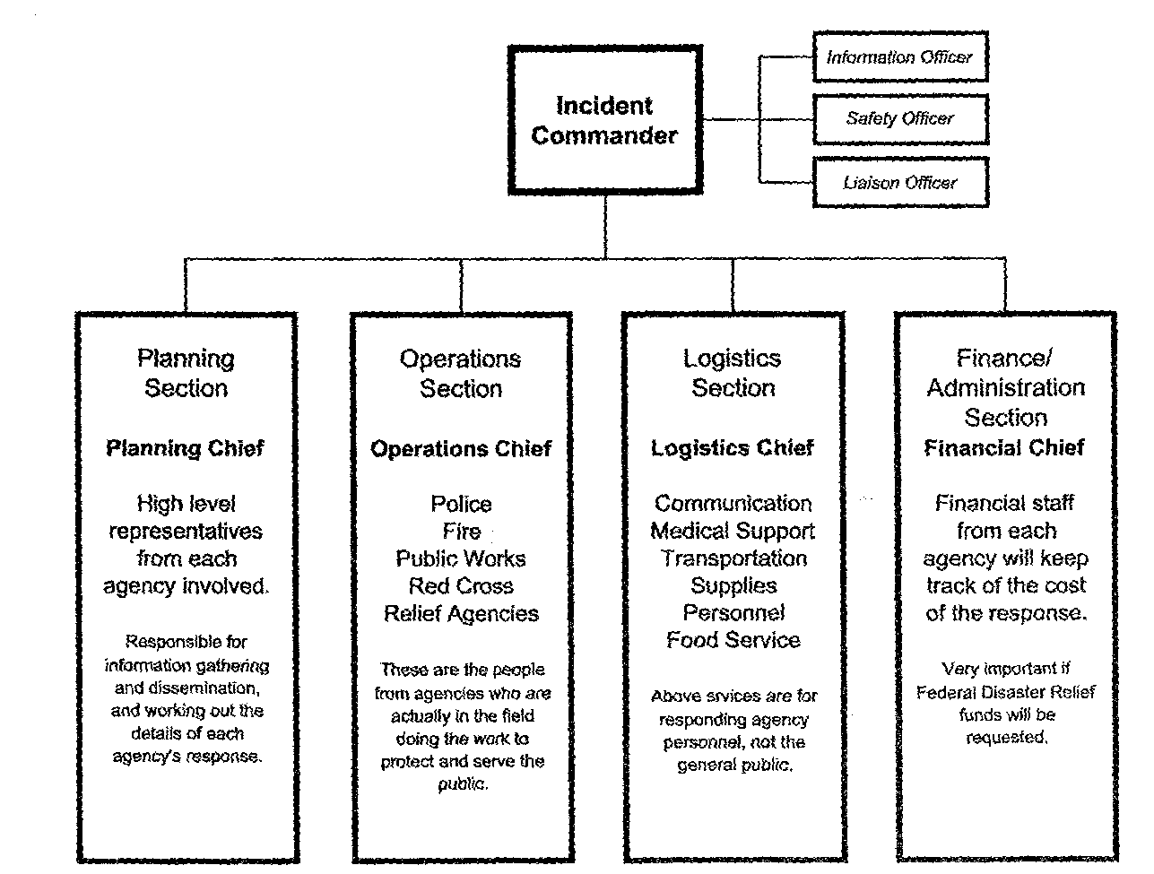
The Incident Command System
LU 16
In addition to the incident commander there are four major operating sections in an ICS. They are planning, operations, logistics and finance/administration.

Slide 122
The Incident Command System
LU 16
ICS
The Incident Command System (ICS) is a management tool designed to bring multiple responding agencies, including those form different jurisdictions together under a single overall command structure.
ICS is not
A fixed unchangeable structure
A means to take control authority away from agencies or
departments that participate in the response.
A way to subvert normal Chain of command
Always managed by the fire department or first agency on
scene
Too big and cumbersome for small everyday incidents
Restricted to use by government agencies and departments

Slide 123
The Incident Command System
LU 16
The incident commander is usually the most senior
on scene officer from the first responding agency. As
the incident continues for an extended period or grows the person filling the Incident Commander position may change but the role of the incident commander does not change.
Involvement in any Incident Command System is by “invitation only” – There is no role for “off the street” volunteers. The relationship between an emcomm group to the ICS structure will vary with a specific situation. You may not have any part in the ICS Structure except through your served agency or agencies.

Slide 124
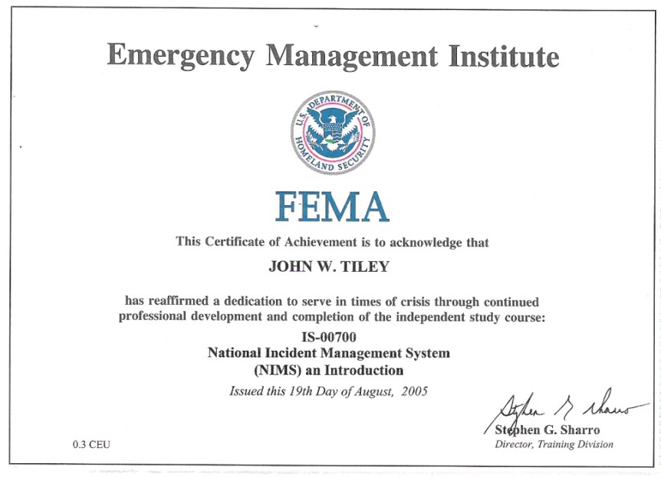

The Incident Command System
LU 16
Emcomm volunteers are encouraged to learn and understand the Incident Command Structure by completing the on line IS-100 Introduction to ICS training on the FEMA website (let your EC know if you take and successfully complete this class):
http://training.fema.gov/EMIWeb/IS/IS100a.asp
Students name

Slide 125
LU11 Review
LU 16
The letters ICS stand for Incident Command System
ICS is a management tool for coordinating the resources of several agencies within a single command structure.
The ICS has two inter-related parts. They are management by objectives and organizational structure.
In addition to the incident commander there are four major operating sections in an ICS. They are planning, operations, logistics and finance/administration.
The emcomm group may or may not be a formal part of the ICS structure during an Incident.

Slide 126
Preparing for deployment
LU 17
Radios
Antennas
Food & Water
When preparing for a deployment or callout,
remember the Boy Scout Motto “Be Prepared”.
What should you be prepared for? As the
Founder of the Boy Scouts Baden Powell said
“be prepared for any old thing”. The same
preparedness goal applies to emcomm volunteers.
Being prepared requires advance planning and having a kit of the things you will need ready to pick up and go. These are called Go Bags or Jump Kits. With out prepared jump kit you will likely leave a critical item or two home or take valuable time looking for items when you are called

Slide 127

Preparing for deployment
LU 17
Before planning your Jump Kit you will need to consider:
  How long you might be deployed (12, 24, 72 hrs or more)?
  Will you have reliable power or will you need your own power?
  Weather that might be encountered (en-route and at site)?
  Will food, water and sanitary facilities be available?
  How will you and your equipment get to the site?
  Carrying an 80 AH battery may not be practical if you hike in
  Can some kit items do double duty to save space and weight?
  Will your emcomm post be fixed or mobile?
  Will operating position shelter be needed (tarp, tent, Vehicle)?
  What networks and nets will you operate in?

Slide 128
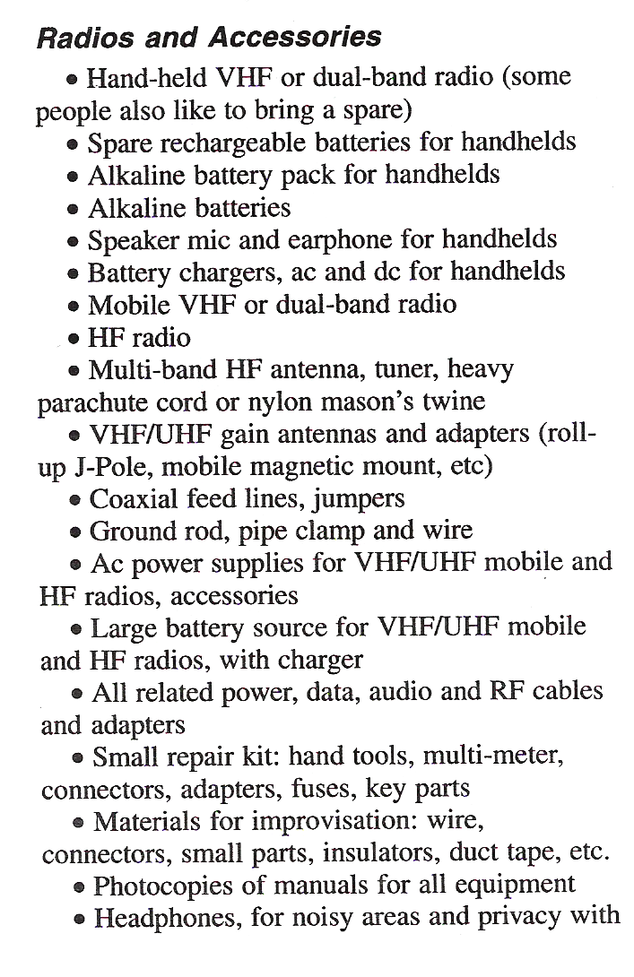
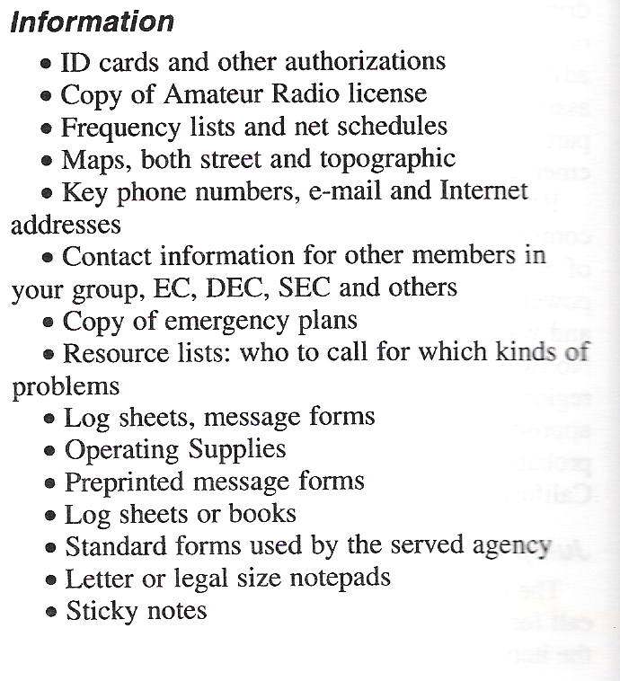
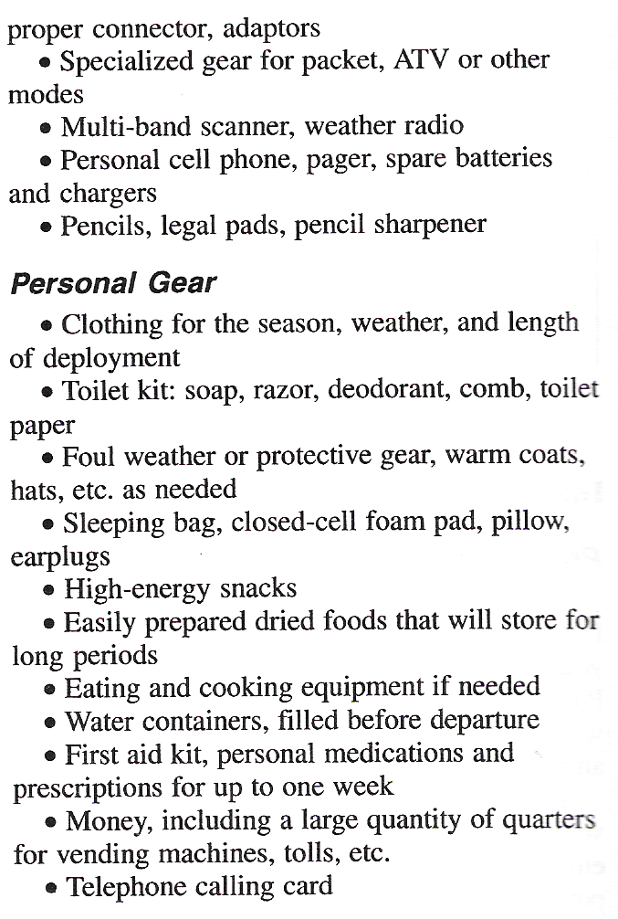
LU 17
Preparing for deployment
Your emcomm course book has a list of jump kit ideas on page 74. (there is also a list on the ARES/RACES web site)

Slide 129
LU 17
Preparing for deployment
It may be efficient to sub-divide your kit into multiple kits so you can take what you need for a particular callout with out carrying everything. Some ideas are:
    Quick deployment kit
    VHF/UHF/HF kit for fixed location
    Accessories and tools kit
    Emergency power kit
    Field Shelter kit
  Pre-planning and physical preparation is the key to an effective and timely emcomm deployment. Check your Jump Kits / Go Bags regularly and rotate perishable items like food and water.

Slide 130
LU 17
Preparing for deployment
Know the frequencies in your area:
Know the local repeater frequencies and coverage.
Know which repeater will be used and where the nets
are likely to be.
Know where the nets may move to in case they experience
interference.
Know what simplex frequencies will be used in case of
a repeater failure.
In Alachua County the primary frequency will be 146.820 repeater with 146.985 as a backup. Simplex operations may be on 146.550 while 146.520 may be monitored for call-ins. Support net for Red Cross may use 147.420 MHz.

Slide 131
LU 17
Preparing for deployment
Train with our served agencies:
  Learn their expectations/needs
  Learn their operation methods and protocol
  Learn their organization
  Identify possible operating locations
  Determine if radio gear is available and how it operates
  Emergency Management (EOC & Shelters)
  American Red Cross (North Central FL Chapter – Gainesville)
  Hospitals (Shands UF, Shands AGH, N. Fla, VA, Specialty)
  Health Department
  National Weather Service (SKYWARN)

Slide 132
LU12 Review
LU 17
Preparing a Jump Kit in advance will ensure you will not leave something at home or lose valuable time looking for critical items when called.
A 12 hour deployment Jump Kit would not contain a camp cot or tent. Your 12 hour Jump Kit would contain an VHF HT or VHF/UHF HT, spare batteries, high energy snacks and bottled water.
Your ID cards and other authorization documentation should be among the most important items to be included in your Jump Kit.

Slide 133
LU12 Review
LU 17
4. A deck of playing cards is one of the least important items for a Jump Kit.
A Jump Kit should contain:
    A frequency list and net schedules
    Contact information for your group and group leaders (EC, DEC, SEC)
    Key Phone Numbers, e-mail and internet addresses
5. If you are assigned to an emcomm operation location in advance one of the least important things you would need to know is the regular business hours maintained at the
assigned location.

Slide 134
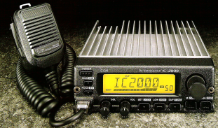
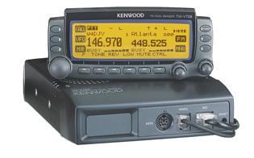


Equipment Choices for Emergency Communication
LU 18
VHF / UHF Transceivers
  The most universal choice for emcomm is the dual
  band 30-50 watt FM transceiver. This class of radio
  is generally rugged, reliable and can operate at fairly
  high duty cycles (an external cooling fan is always a
  good idea and will prolong the life of the radio).
  A second radio to monitor other nets can be quite
  useful. This can be an HT or just a scanner
  programmed for the amateur frequencies likely
  to be used (many of the newer HT’s have a
  scanning function built in)

Slide 135
Equipment Choices for Emergency Communication
LU 18
  When using a second radio be sure to use enough separation between the antennas to prevent de-sensing the monitor receiver when transmitting
Radio Receiver Performance
For radios on all bands there are several aspects of their performance that can effect its suitability for emcomm.
    Sensitivity – The ability to receive weak signals-
    This is primarily a function of the receiver front end
    noise figure or how much noise the receiver front
    end adds.
    Selectivity – The ability to reject signals on adjacent frequencies while selecting the desired frequency.

Slide 136
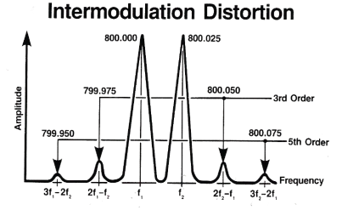
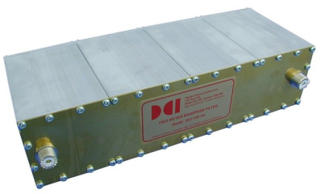
Equipment Choices for Emergency Communication
LU 18
      Intermodulation Rejection – This is the ability of the receiver front end to prevent undesired signals from causing interference. Intermodulation distortion frequently is caused by interfering signals outside the amateur band. Today's radios have wide frequency range beyond the amateur bands that allow interfering signals into the receiver front end. External bandpass filters solve this problem.
      In the field changing to another frequency will most likely eliminate the problem

Slide 137
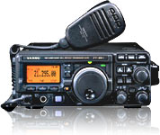
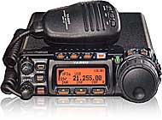
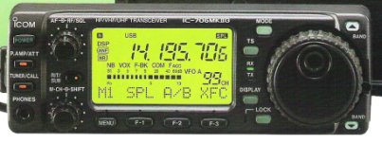
Equipment Choices for Emergency Communication
LU 18
HF Transceivers
  Unless you are running QRP HF radios require
  significant power from emergency generators or
  large batteries. Having an HF radio with both
  AC and DC power (external Power supply or
  battery) is desirable.
  Do not use DC to DC Converters to power HF rigs.
  They may generate a lot of RF “hash”.
  HF radios with adjustable power output allow the
  use of low TX power to extend battery life and
  High power when needed to get through.

Slide 138
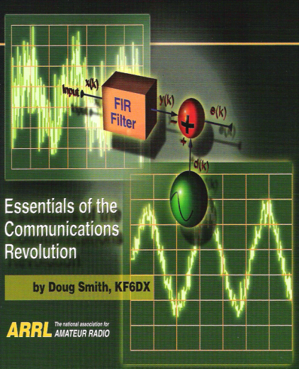
Equipment Choices for Emergency Communication
LU 18
Receiver filters are very important for HF receivers. Choice of filters will depend on the mode of operation (PSK, RTTY, CW and phone).
Digital Signal Processing may be the
single most important filtering feature
available. Internal and external DSP
circuits can allow clear reception of
signals that otherwise might not be
possible in situations with high RF
location or path noise.

Slide 139
Equipment Choices for Emergency Communication
LU 18
VHF/UHF Antennas –
A good antenna mounted as high as possible is more important than high transmitter power. Gain antennas increase your effective signal strength allowing lower power operation for longer battery life.
A unity gain antenna like a J-Pole with fatter lobes may be better for getting out of a valley
Directional antennas are a better choice for Packet to prevent multi-path interference.
Hand held antennas known as “rubber duckies” have
negative gain (loss). Use at least a ¼ wave flexible
antenna for most operations and a 5/8 wave for more range
in open areas.

Slide 140
Equipment Choices for Emergency Communication
LU 18
HF Antennas – There is no single perfect antenna for HF operation.
  For local operation a simple dipole antenna mounted less than ¼ wavelength above the ground works well and is easy to deploy. This is known as a NVIS antenna. An antenna tunner is required.
  A random length wire antenna with a tuner could also be effective. (needs a good ground connection)
  For long range, wire dipoles mounted high above the ground are effective and if properly constructed will not need an antenna tuner
  A trapped vertical antenna may work and a vehicle mounted antenna (Hamsticks, screw driver,etc.) could also be used.

Slide 141

Equipment Choices for Emergency Communication
LU 18
Feedline (COAX) –
You will need enough coaxial cable to connect your radios to the antennas.
Open wire feed line is generally not a good choice because of the difficulty of running it into a building and possible undesired human exposure.
For short runs RG58 may be useable but for longer runs use lower loss cable like RG8X, RG8, RG213 or 9913. RG8X is a compromise but because of its ease of transport it can be a good choice.

Slide 142
Equipment Choices for Emergency Communication
LU 18
Operating Accessories –
Headphones are useful in any location,
mandatory in others to avoid disturbing
others and where multiple radios are in use.
If you have a VOX (Voice Operated Xmit.) headset/mike, turn off the VOX function and use manual push to talk during emcomm events.
If you need hands free operation consider
a desk microphone with a foot switch

Slide 143
Equipment Choices for Emergency Communication
LU 18
Batteries –Battery operation is critical for emcomm operations. You can not rely on AC power being available. Choosing the right battery is a function of the anticipated current drain (dependent on transmit power setting) and expected duration of operations. Keep in mind that you may not be able to recharge your batteries in the field.
  The ability to operate your hand held on disposable AA alkaline batteries is a plus. Alkaline AA battery holders are available for most HT’s.
  Have a cable to connect your HT, mobile, or HF rig to other batteries by using Anderson Power Pole connectors

Slide 144
Equipment Choices for Emergency Communication
LU 18
  For higher power needs, lead acid based batteries are available from a few amp hour capacity to over 100 Amp Hour capacity common types available include:
    Flooded cell automotive type (not recommended) and Marine deep cycle type (recommended).
    Sealed Lead acid (Gel Cells)
    Absorbed Glass Mat (AGM)
  Whenever charging batteries make sure you follow
  the manufactures or industry standard guidelines.
  Batteries can be damaged or explode if they are
  charged with too high a current or too high
  a float voltage.

Slide 145

Equipment Choices for Emergency Communication
LU 18
Other Power Sources –
  Solar Panels and controllers
  Gasoline driven generators
  Wind and water driven generators
  Human powered generators
  Vehicle power and charging
  DC to AC inverters to power computers

Slide 146
Equipment Choices for Emergency Communication
LU 18
Other useful equipment –
  Multi Band Scanners
  A voltmeter to check power sources (with leads)
  FRS/GMRS/MURS hand held's
  Cell Phone* to dial 911
  (*does not need to be registered or have service to dial 911)
  Battery operated AM/FM radio
  Weather Alert Radio
  Laptop Computer
  Desk Microphone
  Foot operated transmit switch

Slide 147
Equipment Choices for Emergency Communication
LU 18
And Most Important:
1. Test your station to be sure it all works and you have
all the necessary cables, coax, adapter fittings, charged or fresh batteries. Field day and SET (Simulated Emergency Test) would be an ideal time to verify you have a complete operational station.
2. Be sure you have identified / marked all your items so they can find their way home after the event.

Slide 148
LU13 Review
LU 18
When Powering HF radios whenever
possible use deep cycle batteries rather
than automotive batteries.
When setting up a VHF/UHF radio a good
antenna is more important than high
transmit power
If space and resources permit, a beam
antenna has an advantage of maximizing
the desired signal path and reducing
interference from other stations.

Slide 149
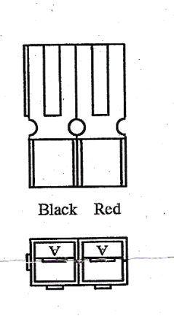
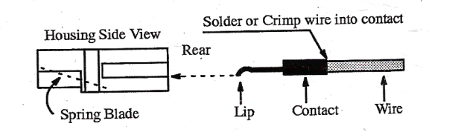
LU13 Review
LU 18
4. The optimum charging voltage for a 12 volt
lead acid battery is two volts more than the
rated voltage, or 14 volts
5. The 30 amp Anderson power pole connector
can be plugged and unplugged a greater
number of times without deterioration than
the 10 amp Molex connector found on many
VHF/UHF mobile rigs

Slide 150
LU13 Review
LU 18
6. Statements on ARES deployment clothing are:
  Three years (until Jan. 1, 2013) are being given to “wear out” and replace older clothing
  The recommended standards increase recognition and acceptance of ARES units
  The recommended standards apply only to clothing worn on actual ARES deployments

Slide 151
Emergency Activation
LU 19
The actual way emcomm volunteers will be notified of an activation will be determined locally and as a function of the emergency. In this lesson we will look at some of the most popular methods.
First every emcomm group should have a formal written plan with its served agency to activate their members when needed.
The plan should be developed in detail and then reduced to a simple check list that both served agency and emcomm managers can keep nearby at all times

Slide 152

Emergency Activation
LU 19
The plan should detail the circumstances under which emcomm activation might occur and should contain all emcomm member names with phone numbers that are periodically verified and kept up to date.
Possible group alerting systems
  Phone Tree
  Paging (a real pager or an HT with a
  channel and specific CTCSS tone sent from the repeater)
  E-Mail Activation
  Self Activation (prepare and listen to repeater)

Slide 153
Emergency Activation
LU 19
I have been notified, now what?
  In most cases go to the emcomm net or meet frequency.
  If heading home to pick up your Go Bag
      Fill your vehicle with fuel
      Pick up supplies you may need for activation
      Notify your spouse and Family about what is happening and set up contact times and method for communication during the activation
  Check in and let NCS know your availability
  Have your Jump Kit / Go Bag ready to go
  Do not go anywhere utill instructed to do so

Slide 154

Review
LU 19
If a telephone tree is activated and you are
unable to reach one of your assigned contacts
on the list you should call all of those assigned
to the person on the list who could not be reached.
An “emcomm activation liaison” for a served
agency is the member of the emcomm group
who is alerted first by the agency.
Regarding emcomm alerting systems it is best
not to rely exclusively upon any single alerting
system.

Slide 155
Review
LU 19
4. E-mail is best used as a backup alerting
system
5. The NCS (Net Control Station) is so
important that several members should
be trained to take on the duties until the
assigned NCS checks in.

Slide 156
Set Up, Operation & Teardown
LU 20
If you have a known assignment or are
available for assignment check into the
net and let NCS know you are available.
Get your equipment loaded up and be
ready to go.
When proceeding to your assignment
check in with NCS on your progress,
especially when travel is hazardous.

Slide 157
Set Up, Operation & Teardown
LU 20
Check in with the person in charge at
your assigned location and tell them who
you are, why you are there and what you
can provide for them.
If you are asked to brief the staff of a served
agency about the privacy of amateur radio
you should tell them that there are no methods
by which the security of any message can be
assured on Amateur Radio
Expect the situation and assignment to
be fluid. Each incident is unique and
may change quickly.

Slide 158
Set Up, Operation & Teardown
LU 20
At each station the EC or emcomm manager
should appoint one member to take a
leadership role as the station manager for
all operations at that station.
When you accept the role of an emcomm
volunteer you do so knowing you will often
need to follow the directions of another
person. Cooperation and teamwork are
essential.

Slide 159
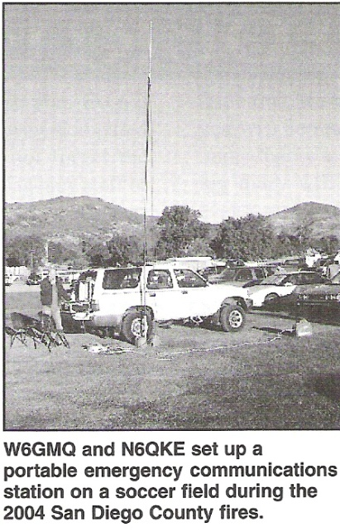
Set Up, Operation & Teardown
LU 20
Expect that sometimes you may be a
leader and at other times you will be a
follower
Plan ahead, if no building or inside
space is available for you and your
radio gear be prepared to operate
out of you vehicle or bring a tent
or other shelter.

Slide 160
Set Up, Operation & Teardown
LU 20
When setting up your gear on a desk, table
or other location where someone else's “stuff”
is in your way, carefully store it in a safe place,
like a cardboard box you can seal, label it so it
can be safely stored out of the way until the event is over.
After the event is over place the box of “stuff” back on the desk or table but leave it in the box. Do not try to remember how it was set up or try to place it back that way.

Slide 161
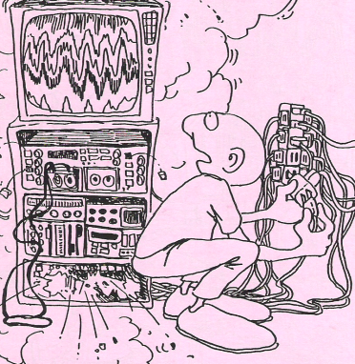
Set Up, Operation & Teardown
LU 20
Your first order of priority will be getting a
station setup and checking in with NCS.
Once your station is on the air and you have
checked in with NCS you can check your
location to determine what other resources may be available:
  Computer/internet, fax machines, telephone lines
  Determining what frequencies and signal paths are available (repeaters and simplex paths)
  Learn about the Served agency role at this location and their communication needs
  Food Water, Sanitary facility availability
  Setting up additional radios (may need to wait for help)

Slide 162
Set Up, Operation & Teardown
LU 20
Directions to end operation may come from the served agency or from NCS.
Unless there is imminent danger, when a
served agency manager tells you to end
operations you should notify NCS before
closing your station.
If you had to close the station quickly because of an emergency, contact NCS as soon as it is safe and let them know what is going on.

Slide 163
Set Up, Operation & Teardown
LU 20
Before leaving clean up the area you occupied and remove any trash, coffee cups and pop cans that accumulated during the event.
After the event collect your messages and
notes and save them for an emcomm team
debrief session (sometimes your notes
and message copies will be turned over
to the served agency manager before leaving).

Slide 164

Set Up, Operation & Teardown
LU 20
After an emergency station operation, your
emcomm group (and possibly the served
agency) will want to hold a debriefing session.
The purpose of the debriefing sessions is to review what worked well, issues that may have arisen and where improvements are needed for future operations.
Jotting down notes during the event will help
your memory for the debrief session that
follows the event.

Slide 165
Review
LU 20
If you have been activated during an emergency and have been told to report to an agency that is different from your usual assignment you should introduce yourself to the person in charge as the emergency communicator assigned to that location
If you are asked to brief the staff of a served agency about the privacy of amateur radio you should tell them that there are no methods by which the security of any message can be assured on Amateur Radio

Slide 166
Review
LU 20
3. If you have been assigned to a site and the emergency ends and the site manager asks you to close your station; you should you should check in with the emcomm manager or net control before closing down.
4. In preparing to leave a site after an emcomm event you should not unpack all desk items you placed in boxes and put them back in their original locations.
5. The primary purpose for a debriefing after each emcomm event is that affords an opportunity to improve future emcomm activities.
Notes:
166

Slide 167
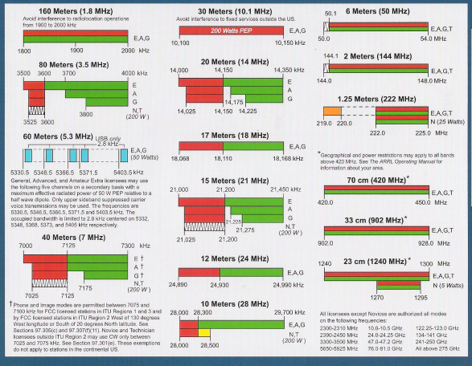
Operations and Logistics
LU 21
One of the values Amateur Radio
brings to the table is a vast amount
of radio spectrum;
Most local and regional emcomm traffic will be on 2 meter and 70 cm FM, or on 40, 60 or 80 meter SSB and CW.
VHF and UHF FM are preferred for most local operation because the equipment is common, antennas are smaller, and communications are clearer.

Slide 168
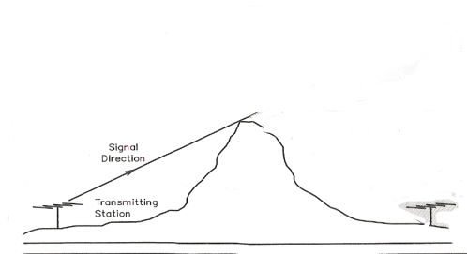
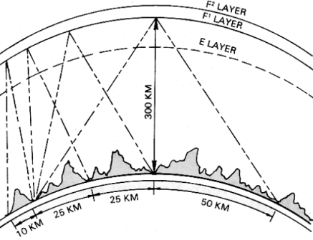

Operations and Logistics
LU 21
VHF and UHF communication range is
determined by terrain, antenna height
and availability of repeaters.
For larger areas or those with out repeaters
most local emcomm operation will be on the
40 and 80 meter bands using NVIS (Near
Vertical Incident Skywave) antennas.
Your jump kit should have a list of
frequencies commonly used for emcomm.

Slide 169
Operations and Logistics
LU 21
You should become familiar with coverage,
and features or each permanent repeater
    Are there dead spots in the repeater coverage?
    How much transmit power required to hit the repeater?
    What features are available (like phone patch, Echo Link etc.)?
    How does the repeater identify?
    Does it have a courtesy tone?
    Does it have a time out, how long, how is it reset?
    Are there inks to other repeater systems?

Slide 170
Operations and Logistics
LU 21
You should become familiar with coverage,
and features or each permanent Packet node,
digipeater and other means of digital communication like Packet-Pactor, WinLink, PSK31, RTTY, etc in your area.
    Are there mail boxes?
    Do they have digipeater functions?
    Do they have bulletin boards?
    Which software do they use, how can you communicate through it?
    What other nodes can they connect to?
    How many communications can the support simultaneously?

Slide 171

Operations and Logistics
LU 21
If all else fails and simplex communications are
spotty consider placing a mobile station or
portable repeater on a hill top or on the top of a
tall building.
Portable Battery operated repeaters are a
good resource to have available. They are
easily and quickly deployed when and where needed.
Permanent repeaters designated for emcomm
use should have backup power available
(batteries and/or generator)

Slide 172
Operations and Logistics
LU 21
In addition to the main net frequency each net
should have several alternate frequencies
available. A couple in case of interference
on the main net frequency and a couple for
stations to pass traffic “off net”.
If there is no direct path between NCS and the
emcomm station a relay station should be
identified to relay incoming and outgoing traffic.

Slide 173
Operations and Logistics
LU 21
Most served agencies will expect you to keep records of your operations. Your records should include copies of messages received and sent, station log memos and any official correspondence.
In Some agencies your station records are permanent and important legal documents and must be treated as such.
To protect equipment and the messages you handle an prevent distractions it is best to allow only the operators who are on duty to be in the communications room.

Slide 174
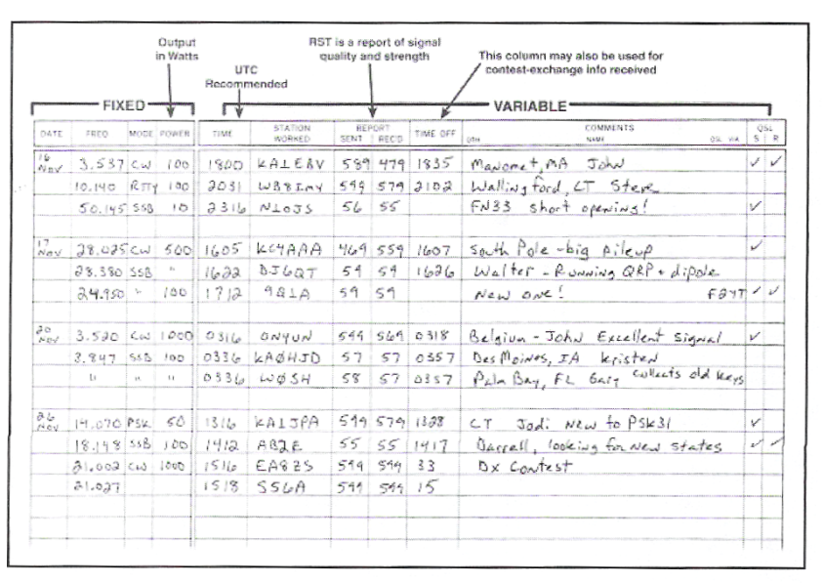
Operations and Logistics
LU 21
Station logs should contain:
  Arrival and departure times
  Times for nets you can you checked into
  Times for nets you can you checked out of
  Message number, sender and addressee
  Special handling instructions
  Critical events (damage,
  power loss, injuries,
  earth tremors)
  Other emergencies

Slide 175
Operations and Logistics
LU 21
An unusual event such as an emcomm emergency response to a disaster can create incredible amounts of stress. When under extreme stress individuals can become:
    Disoriented & Confused
    Unable to make decisions
    Lose their tempers
    Behave in ways they would not at any other time

Slide 176
Operations and Logistics
LU 21
Extreme stress can lead to nervous breakdowns
  Take a break. You can’t do it all now
  Step back and take a few deep breaths and relax
  Prioritize your assignments and duties
  Delegate some of your responsibilities
  Do not take comments personally \ Look at them as constructive criticism
  Pay attention to your own needs (Food, water, medical needs, sleep)
  If someone is losing control of a situation bring someone else in to assist (or let your manager know they need help)
  Take a minute to think before responding to a stress causing challenge

Slide 177
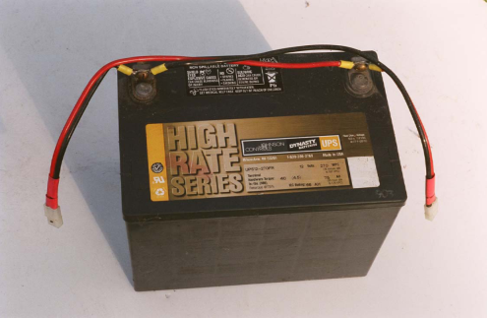
Operations and Logistics
LU 21
If operating from battery power you will
need to:
    Have enough batteries for the expected duration
    Find a way to recharge them if long operating
    times are required (may not be practical for slow
    charge batteries)
    Have standard connectors on the battery and radio
If using a gasoline generator think about it’s placement to prevent Carbon Monoxide from entering inhabited areas and ensure its acoustical noise causes minimum disturbance to others.

Slide 178
Operations and Logistics
LU 21
In the world of modern emcomm you may be asked to handle other assignments for the served agency that may or may not include communications.
At one time the answer was a hard and fast “NO”
Today most emcomm groups will let their volunteers be cross trained to perform a variety of served agency skills that also involve communications:
  SKYWARN weather spotting
  Red Cross Damage Assessment
  Red Cross logistics Jobs
  Situations where you could do both jobs

Slide 179
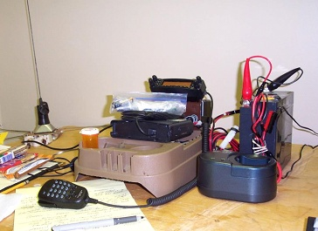
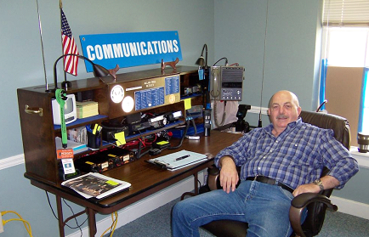
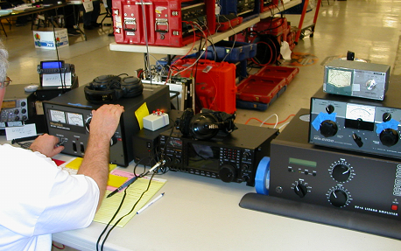
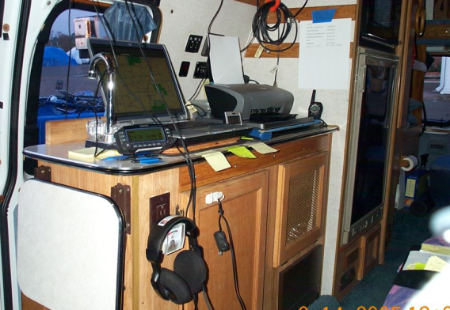
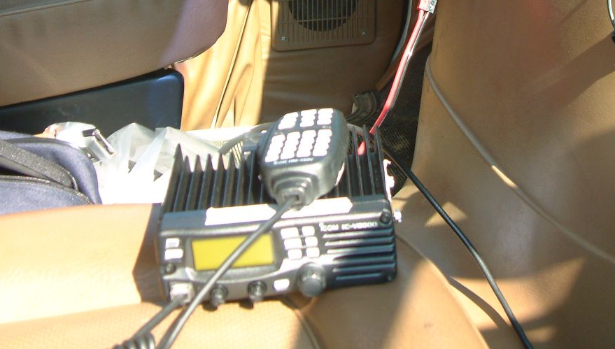
Operations and Logistics
Some Portable stations used during Katrina ranging from
an HT with gel cells to a kilowatt HF station

Slide 180
Review
LU 21
Terrain, output power and antenna gain will
limit VHF simplex communication range.
Increasing antenna height, increasing
transmitter output power and moving
the antenna away from obstructions will
improve simplex reception (range). Switching
to a non-directional antenna will not improve
reception.
The FCC rules do not permit unattended
operation of simplex repeaters.

Slide 181
Review
LU 21
Driving a delivery vehicle for a served
agency would not be an appropriate
assignment for an emcomm volunteer.
5. Prioritizing you actions with the most
important and time sensitive first on the
list is a good means of dealing with stress
during an emcomm event.

Slide 182
Personal Safety, Survival & Health
LU 22
As a disaster relief volunteer, do not get so involved in helping others that you forget to take care of yourself. You need to keep yourself in good condition so you are able to assist others.
Before leaving home for an assignment be
sure you have made all the necessary
arrangements for the security, safety and
general well being of your family.
Set up a communication plan with your family.

Slide 183
Personal Safety, Survival & Health
LU 22
In addition to your emcomm checklist you may want to create a home and family checklist.
Some things to consider:
  If you will be without power in an area where it will freeze drain your water pipes.
  Heating fuel tanks should be filled
  Shut off power and gas
  Board up windows
  Move valuables to an upper level
  Ensure your family has reliable transportation with a full fuel tank
  Emergency food and water supply.
  Prescription medications

Slide 184
Personal Safety, Survival & Health
LU 22
When You leave
  Food (2000 calories a day) Freeze dried camping food,
  Energy bars, military style Meals Ready To Eat (MRE)
  and small camp cook stove.
  Water (1 gallon per day recommended, 2-3 liters per
  day to survive). Questionable water can be purified by
  adding 2-4 drops (1/8 teaspoon) of unscented liquid
  Clorox laundry bleach to a gallon of water and leaving
  it sit for 30 minutes.
  Personal Hygiene items- Tooth paste, tooth brush,
  deodorant soap or waterless hand cleaner

Slide 185
Personal Safety, Survival & Health
LU 22
When You leave (continued)
  Prescriptions
  Extra glasses (or safety glasses) in
  a hard, felt lined case.
  Cash – Do not assume there will be a cash machine
  or that food an fuel can be paid for with a Credit/Debit card.
  There is a sample personal survival and comfort check list on pages 108 and 109 in your Emcomm I Training manual

Slide 186
Personal Safety, Survival & Health
LU 22
Safety in unsafe places. Many times you will be sent to areas that can be dangerous and pose safety risks.
  Understand the environment before entering.
  Wear appropriate clothing and if appropriate gloves and boots.
  A hard hat might be appropriate in some situations
  Avoid industrial areas where toxic chemicals nay be stored.
  Always be sure you have more than one exit from your operating location.
  Carry a Police or signaling whistle so you can let rescuers know where you are if you need to be rescued
  Flashlight and if possible a chemical light stick

Slide 187
Review
LU 22
Water purification tablets will not remove
Bacteria and dirt (it will kill bacteria but
not remove dirt).
It is best to use two to four drops
(or 1/8 teaspoon) of plain, unscented,
liquid chlorine bleach to a gallon of water
to purify it for drinking.
Keep spare eyeglasses or safety glasses in a hard felt lined storage case in your go bag.

Slide 188

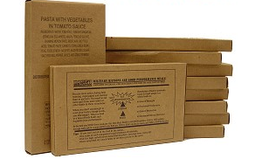
Review
LU 22
4. Because many disaster assignments are
in unsafe places you should always plan
more than one escape route from
buildings and other hazardous locations.
5. Your personal safety and well-being are a higher priority than the mission.
6. An MRE meal is a package meal that
can be stored for a long period of time
and requires a minimum of preparation.
MRE stands for Meals, Ready to Eat.

Slide 189
ARES PIO: The Right Stuff
LU 23
Public Information Officer (PIO)
  “Providing the Right information to the Right people at the Right time so they can make the Right decisions” -- FEMA Advanced PIO Course
Agency PIO
  Media Relations
  Part of the ICS Team
  Silence is as bad as errors – rumors start
  ICS standardize ways to be a unified voice
Unified Command (UC) – All agency PIOs report to the Joint Information Center (JIC)
ARES PIO
  Expert on Amateur Radio
  Introduce other ARES members to the Media
  PIO and operators are properly dressed
  Avoid interviews with inappropriate dressed members

Slide 190
Review
LU 23
A Joint Information Center is established to:
  Formulate a unified voice and message
  Dispel rumors
  Provide a central location for media questions
If a reporter shows up at your ARES deployment, but you’re not the PIO, refer them to the JIC, designated Lead PIO or ARES PIO.

Slide 191
Alternative Communication Methods
LU 24
Amateur radio may not be the only radio
service for the job.
Handing an official a hand held radio to stay
in contact with the ARES/RACES team may be better than shadowing the official, epically when the official is involved with sensitive issues.
The amateur radio emcomm team should be equipped to communicate with other communication networks and types.

Slide 192
Alternative Communication Methods
LU 24
Some of the alternative communication radio services require licenses, others require group licensed and still others require no license at all.
You can easily modify many of today's
2 meter/70cm radios to operate on a nearby
public service or business band radio service frequencies. You should think carefully about how you will use the modified radio vs. the risk of accidentally transmitting on a frequency in another service.

Slide 193
Alternative Communication Methods
LU 24
CB (Citizens Band) radios
  No License required (Can’t ID with your Amateur
  callsign but you can still use your old CB call
  if you had one when the FCC issued licenses.)
  AM (Some SSB) - Voice communication only.
  5 watts input to final maximum.
  Operate on 11 meters (26.965-27.405) on 40 assigned channels.
  Used by emergency teams like REACT
  Typical range is 2-8 miles for mobiles, 25 for base to mobile operation,. FCC limits the max allowable range to 75 miles.
  Channel 9 is still monitored for emergency traffic by some emergency responders in more rural areas. Truckers use Channel 19 on the Interstate and other road networks.

Slide 194

Alternative Communication Methods
LU 24
FRS (Family Radio Service) radios
  No License required
  No Base Stations, only HT’s
  FM voice communication only.
  100-500 mw transmit power .
  Operate in the 462 MHz range
  14 channels with CTCSS tone capability
  Used by emergency teams like REACT
  Typical range is 1-5 miles
  Channel 1 is monitored by REACT for emergency traffic

Slide 195

Alternative Communication Methods
LU 24
MURS (Multi Use Radio Service)
  No License required (the new Citizens Band)
  Personal and business communication allowed.
  Primarily for mobile and portable use.
  Maximum of 2 watt transmit power .
  Operate on 151-154 MHz, FM Voice only.
  14 channels with CTCSS tone capability.
  Used by emergency teams like REACT.
  Range is similar to a 2 meter hand held on simplex.

Slide 196
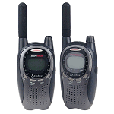
Alternative Communication Methods
LU 24
GMRS (General Mobile Radio Service) radios
  License required – No Call sign
  No Base Stations, only HT’s
  FM - Voice communication only.
  5 watt max transmit power on channels shared with FRS
  50 watts on non FRS Channels
  UHF Frequencies between 462.5625 to 462.7250 MHz
  FM Voice only.
  15 channels with CTCSS tone capability.
  8 channels are paired with a repeater frequency 5 MHz higher.
  No Frequency Coordination or assigned frequency for users.

Slide 197

Alternative Communication Methods
LU 24
Public Service Radio (Police, fire)
  May allow you to train to use their radios.
  Only use if directed by an officer
  Keep transmissions short.
  Cease transmitting if they tell you to
  Do not modify your radios for these bands.
Cellular and PCS Phones
  In smaller events these may still be viable
  Offer more security than Amateur Radio
  Can Send text messages

Slide 198
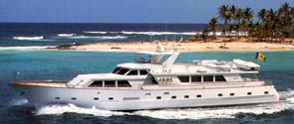
Alternative Communication Methods
LU 24
Marine Radio
  Allocated channels on the 160 MHz Band for
  Ports and Inland waterways.
  No License requires for US waters operation.
  FM Voice.
  25 watt transmit power
  Chanel 16 monitored by Coast Guard.
  Additional HF Frequencies allocated between 2 and 30 MHz for long range SSB Communication
  IF you hear a vessel and no one is responding you are permitted to answer the distress call and determine the nature of the emergency and relay the message to the coast guard or other authority.

Slide 199
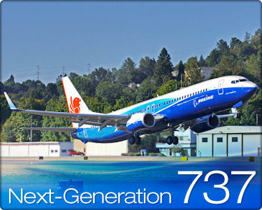

Alternative Communication Methods
LU 24
Aviation Radio
  108 to 136 MHz (108-118 for navigation,
  118-136 MHz reserved for Voice communication).
  Military aircraft use 225 MHz to 400 MHz
  AM Voice.
  Emergency frequency is 121.5 MHz for
  commercial aircraft and 243.0 for Military aircraft.
Non-Radio Communication
  Land line telephone if it is still working
  FAX
  Email
  Courier

Slide 200
Review
LU 24
You can not use your amateur call sign on citizens band even if you were a licensed amateur when 11 meters was an amateur band.
Call at regular intervals on channels 9 and 19 when trying to summon help on a citizens band radio.
FRS Radios are readily available at low cost, operation is simple and requires little training and there is no licensing requirement for FRS. FRS radios have limited range because they have low transmit power and can not be connected to an external antenna.

Slide 201
Review
LU 24
4. Any individual can license a GMRS system for personal and family use.
5. Data Emissions are not permitted on MURS (Multi-Use Radio Service)

Slide 202
What to Expect in Large Scale Disasters
LU 25
At the onset of a disaster:
  There is a huge increase of volume in traffic
  on public service radio channels.
  Prolonged waiting periods to gain access to communications.
  Outages may occur in key areas.
  Messages are not handled in priority order and
  are sometimes lost.
As additional agencies arrive:
  There is a need for agencies to communicate with each
  other but may be unable to use each others frequencies.
  Their communication procedures may be different.
  Agencies are reluctant to have others operate their equipment

Slide 203
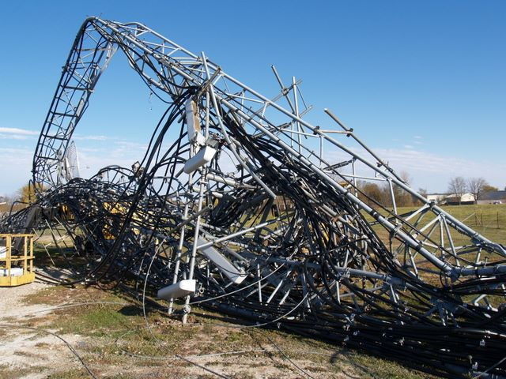
What to Expect in Large Scale Disasters
LU 25
During initial phase:
  Agencies may need to contact
  others more than 350 miles away.
  Message reply delays lead to
  deferred decisions on crucial matters.
Different modes of communication are required in
addition to voice.
  Volume data in printed form (High speed packet & Fax).
  Morse code and PSK31 for difficult reception conditions.
  Encoded data for privacy.
  Telephone interconnects to and from radio systems.
.

Slide 204
What to Expect in Large Scale Disasters
LU 25
During the first 72 Hours of a disaster:
  It takes precious time to overcome obstacles.
  Communication is one of the vital resources that can be difficult.
  The greatest concentration of relief effort is generally found in incorporated cities served by agencies with paid professionals.
  Rural areas suffer because of their remoteness and limited resources.
  Frequently the public is isolated, unable to call out for help or determine what their course of action should be.
  Lack of information leads to further attempts to use the already overloaded phone systems.

Slide 205
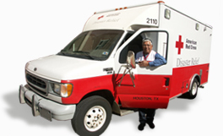
What to Expect in Large Scale Disasters
LU 25
After the first 72 hours the disaster area
usually remains in virtual isolation from
the rest of the world.
The American Red Cross is the
organization that handles health
and welfare on behalf of the victims.
Amateur radio plays an important role of
communicating health and welfare information.

Slide 206
Review
LU 25
The first thing that happens after a disaster occurs is a massive increase in the volume of traffic on public service radio channels.
One of the big issues in an emergency is that agencies all use different frequencies and inter- agency communication is not possible.
The greatest concentration of relief efforts during the first 72 hours of a disaster will be found in urban areas.

Slide 207
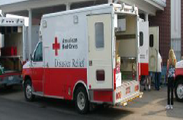
Review
LU 25
4. The American Red Cross is the
organization that handles health
and welfare on behalf of the victims.
5. In the initial 72 hours following a disaster
the disaster area usually remains in virtual
isolation.

Slide 208

Hazardous Materials Awareness
LU 26
You may pass through a HazMat (Hazardous
Materials) Incident en route to an assignment
or be stationed at a HazMat incident.
HazMat materials include liquids, solids and gasses that are corrosive, poisonous , or radioactive, explosive or otherwise hazardous to your health and that of others.

Slide 209
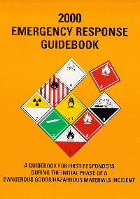
Hazardous Materials Awareness
LU 26
Proper training is required for your safety around HazMat incidents.
The US Department of Transportation (DOT) is responsible for the safety regulations for the transportation of hazardous materials.
DOT has defined Hazardous materials by a
class designation and has established
standardized Hazardous material in placards
and other markings requirements for vehicles transporting them

Slide 210
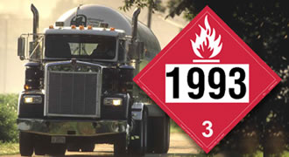
Hazardous Materials Awareness
LU 26
All freight containers, railcars, and trucks transporting Hazardous materials must display the diamond
shaped placard identifying the class (or classes)
of materials they are carrying.
A commonly seen placard is the one with the number 1203 (Petrol) will be seen on Gasoline tankers delivering fuel to your local service station.
The sign placard with 1993 is for
diesel fuel

Slide 211

Hazardous Materials Awareness
LU 26
The National Fire Protection Association (NFPA) has devised a marking system to alert fire fighters to the characteristics of hazardous materials stored in stationary tanks and facilities. The system is known as the NFPA 704M. In consists of a diamond shaped placard with 4 smaller diamonds.
The numbers in the diamonds represent the hazard to humans on a scale of 1 to 4 (4 being the highest).
The colors are
      Red - Fire Hazard
      Blue - Health Hazard
      Yellow - likelihood to explode or react

Slide 212

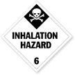
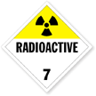


Hazardous Materials Awareness
LU 26
You should report what you see if asked, but do not get to close to the HazMat Incident. Information that would be helpful to report would be:
    Location of incident and location
    What kind of incident
      Spill
      Gaseous cloud
      Any visible placards on building, tanks or vehicle

Slide 213
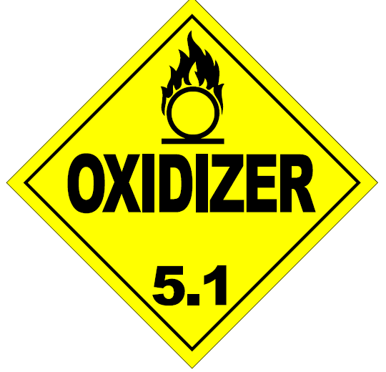
Review
LU 26
You should be located as far away as necessary to ensure your safety when in the vicinity of a HazMat incident.
The Department of Transportation is
Responsible for warning the public about
hazardous materials containers and
shipments.
You should be far away so that no vapors
or fumes are present before transmitting
in the area of a HazMat incident.

Slide 214
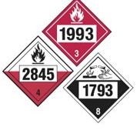


Review
LU 26
1203
4. On the sides of transporting vehicles different classes of hazardous materials are identified by placards, four digit numbers and warning labels or icons.
5. Gasoline tankers filling a neighborhood
gas stations underground tanks are
identified with a placard bearing the
number 1203

Slide 215

Marine Communications
LU 27
The most common for marine
communication is
  VHF FM voice
  Range is 1-15 miles ship to ship
  Range is 20-30 miles ship to shore
  In the 156-162 MHz range
Vessels outside the FM communication range will have MW/HF or satellite radios for communication .

Slide 216

Marine Communications
LU 27
Marine FM radios are marked in channels rather than frequency.
The Marine FM channels are assigned for specific purposes:
    Channel FM 16 – Calling frequency and distress calling frequency.
    Channel FM 9 – Alternate calling frequency.
    Channel FM 83 – Coast Guard Auxiliary.
    Channel FM 22 – Communication with the Coast Guard, but only when specifically instructed to go there.
    Channel FM 23 – Us Coast Guard

Slide 217

Marine Communications
LU 27
Calling an emergency on a marine radio:
  MAYDAY-MAYDAY - Highest priority distress
  signal, grave danger, immediate assistance is
  needed.
  PAN-PAN (pronounced Pawn - Pawn) urgent
  call concerning safety of vessel or person.
  SECURITE - Official message regarding safety
  of navigation or weather warnings.
  SILENCE – The Coast Guard may order silence
  on a specific channel and limit it’s use to activities
  involved in an incident or emergency.

Slide 218
Marine Communications
LU 27
The following information should be obtained from the vessel in distress:
  Position of the vessel involved (GPS lat/long if possible)
  Number of persons on board
  Nature of distress
  Name and call sign (if there is one) of the vessel
  Type and length of the vessel
  Description of the vessel including color
  Weather conditions on scene
  If they have an EPIRB or PLB (Personal Locator Beacon) on board and it’s class

Slide 219
Marine Communications
LU 27
Once you have the information advise all persons to don their life jackets.
Then call the nearest USCG facility or 911. Let them know how to contact you in case you are the only link to the vessel in distress.

Slide 220
Review
LU 27
It is only permissible to use Marine FM channel 22 when Instructed to do so by the Coast Guard
If you hear a marine distress call and it goes unanswered after listening, you should respond and gather all the information possible then contact the nearest Coast Guard facility
You must identify yourself on all transmissions on a VHF Marine radio

Slide 221
Review
LU 27
4. Only Seagoing vessels operating outside the range of VHF communication are authorized to transmit on the marine MW/HF SSB frequencies.
5 Marine FM channels 9 and 16 can be used to call another vessel

Slide 222


Modes, Methods and Applications
LU 28
You will need to choose the best method of communication for each situation in an emcomm environment.
Communications concepts to consider.
Communications modes fall into several categories:
  Point to point – Telephone and some digital modes
  Multi-point – Voice and CW and some digital radio modes
  High precision – Fax, e-mail and digital modes
  Low precision – Voice, CW and Telephone
  High priority – Voice, telephone
  Low priority – Fax, e-mail, digital modes, CW

Slide 223
Modes, Methods and Applications
LU 28
Messages fall into similar categories:
  Point to point – Messages intended for one party.
  Point to multi-point – Messages intended for a group.
  Multi-point to point – Messages from group members to one station .
  High Precision – Lists of items, medical or technical terminology, specialized or detailed information.
  High Priority – Fast delivery is critical.
  Low priority – Messages can be delivered in a more relaxed time frame.

Slide 224
Modes, Methods and Applications
LU 28
Each message type should be sent using the
most appropriate mode based on the message
content and destination.
Remember radio may not be the only means of communication available at a site. For example,
if you are at a Red Cross shelter with power:
  Consider using a power supply for the radio to save batteries.
  If fax or telephones or internet are available at both ends use them, but be prepared should they go down on either end to use radio communication.

Slide 225
Modes, Methods and Applications
LU 28
Do not use voice for messages that are long,
detailed, or technical in nature if an alternate
means or mode is available.
Think about who may be monitoring before
sending sensitive or private information.
Consider that the press, general public and
thieves may be monitoring what you transmit.
  Some modes provide an increased level of security
  No amateur radio transmission is totally secure.
225

Slide 226
Modes, Methods and Applications
LU 28
Digital modes:
    Can be useful in passing large volumes of traffic.
    Can provide error free transmission (many have error correction) of input data, can be saved at either end for re-transmission, printing or archiving.
  What digital modes are available?
    For HF the best digital modes are Packet, AMTOR mode B and PSK31.
    For VHF/UHF The TNC 2 (Terminal Node controller version 2) Packet is the most common

Slide 227
Modes, Methods and Applications
LU 28
Additional Modes
  APRS for location and short messages
  Amateur TV
    Slow Scan images via HF
    Real time TV on 70 cm and above

Slide 228
REVIEW
LU 28
Your purpose as an emergency communicator is to provide accurate and rapid transfer of information from one place to another.
Tactical messages are generally low precision and time critical.
Long lists and detailed messages are best handled by FAX or Digital mode transmissions.

Slide 229
REVIEW
LU 28
4. If absolute privacy is required do not transmit the message by amateur radio.
5. The QPSK mode of PSK31 features error correction.

Slide 230
Other Learning Opportunities
LU 29
Regularly scheduled nets provide an excellent opportunity to practice net procedure. Nets are also a good opportunity to practice being net control operator.
Local ARES/RACES formal training and both on and off the air.
Public service events and formal training like SET, SKYWARN recognition day and Field Day offer excellent setup and on the air practice.

Slide 231
Other Learning Opportunities
LU 29
There is additional training and resource material available on the ARRL website that can be downloaded and printed for free:
    ARRL Public Service manual
    ARES Field Resources Manual
    ARRL Net Directory
    Alachua County ARES/RACES web site
Check your training manual for additional resources

Slide 232
Review
LU 29
Regularly scheduled nets, on air training sessions and public service events are recommended as a means of practicing actual emcomm skills. Discussion groups are not a means of practicing communication skills.
The purpose of the ARRL’s Public Service and Emergency Communications Management for Radio Amateurs course EC-016 is to prepare individuals for management level jobs such as EC, DEC or SEC or other leadership or training roles.

Slide 233


Congratulations!!
You have completed the
ALACHUA County ARES/RACES
ARRL EMCOMM BASIC training class!!!!!

